Slide 1
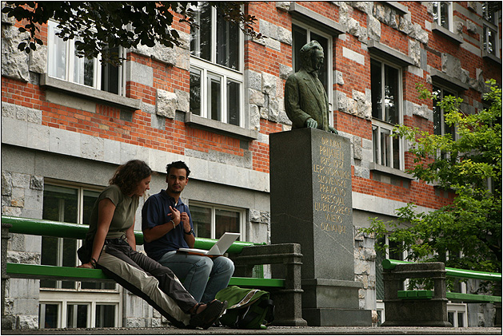
Special collection of library material and international organizations in the National and University Library of Slovenia
Veronika Potočnik
National and University Library Slovenia

Slide 2
National and University Library of Slovenia
Slovenian national and university library,
formation of a library is associated with the decree of Empress Maria Theresa in 1774, which has 637 books devoted to the general public in the library,
after the end of World War I in 1919 with the renaming of the National Academic Library became a central library for the whole country with the right to receive legal deposit prints,
in 2003 NUK became an associate member of the University of Ljubljana,
in 2005 he began to build a digital library of Slovenia,
in 2009 he became a national e-content aggregator in the field of culture.

Slide 3
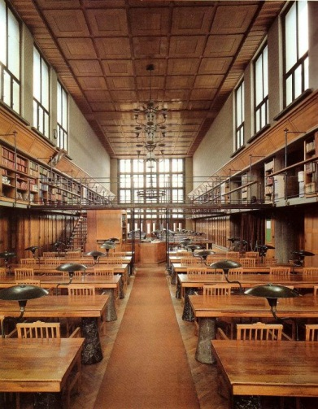
National and University Library
Like other national librarys we have also special collections such as:
Manuscript collection and Early Printed Collection
Old print collection
Music Collection
Map and Pictorial Collection
Ephemera collection and international organizations
Serials Collection

Slide 4
Ephemeral collection (PKG) and International organizations
established in 1978 as a collection of special materials,
massive inflow of fine prints (or ephemeral publication),
influx from the former Jugoslavija until 1991,
the ephemeral publicatin is obtained as legal deposit (2 NUK and 2 UKM),

Slide 5
What kind of ephemeral publication we have?
Catalogs,
programms,
teaching aids,
calendars,
advertising materials (political parties, municipal materials, etc.),
informational materials.

Slide 6
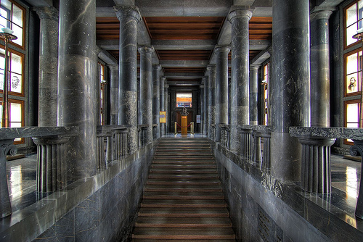
What depozit Librarys of international organizations we have?
EU
UNESCO
ILO
OECD

Slide 7
Material flow statistics
Year | Ephemeral materials (small prints) | EU | OECD | ILO | UNESCO | Library of Congress
2004 | / | 332 | / | 29 | 20 | 61
2005 | 4.326 | 317 | / | 12 | 19 | 60
2006 | 3.117 | 342 | / | 6 | 18 | 59
2007 | 7.124 | 350 | / | 18 | 21 | 60
2008 | 4.177 | 401 | / | 6 | 20 | 179
2009 | 4.352 | 501 | 184 | 30 | 66 | 87
2010 | 3.400 | 212 | 250 | 5 | 82 | 86
2011 | 4.583 | 360 | 118 | 20 | 31 | 99

Slide 8
Library collections of National and University Library (bibliografic unit)
Types of material | Stanje 2011
Monographs publication | 1.306.353
Serials publication | 360.247
Maps | 75.637
Pictures material | 175.986
Music materials | 82.262
Audio (music) | 29.780
Video | 29.743
Microform materials, | 4.199
Multicast materials | 632
Computer materials | 4.293
Emphemeral materials | 567.458
Manuscript materials | 8.725
Standards | 11.924
Three dimensional materials | 88
TOGETHER | 2.657.327

Slide 9
Depozit library of the EU
Quantitatively the most numerous,
status of EU Depository Libraries, the Commission granted the Library in 2000,
22nd April 2004 the collection was officially opened.

Slide 10
Depozit library of the EU – main purpose
Access to information and all publications and other sources of information on EU and EU,
effective IT support,
produce thematic queries on the user's request,
introduces users to basic search information,
provide training on EU information sources for librarians.

Slide 11
How the material is placed?
Organized in 18 thematic groups (like: general institutional matters, agriculture, fisheries and forestry, legislation, social issues, competition and entrepreneurship, science and information, statistics etc.),
The collection is freely accessed,
but it can be only used in the reading rooms of NUL.

Slide 12
Types of materials in EU collection
Political and official documents,
fundamental works,
statistical yearbooks,
annual reports,
programms,
work plans,
studies and research,
different calls,
Slovenian publications on the thema of EU or other (not published by EC) – like disertations, working books, etc.

Slide 13
Trainings for librarians - Getting to know the European Union – the purpose of the training
Present closer to the concept and idea of the European Union,
learn basic concepts, major institutions,
acquaint themselves with the most important domestic and foreign information sources,
enable users to independently search for information on EU and EU.

Slide 14

Trainings for librarians - Getting to know the European Union
From 1999 it was many participants,
in 2004 when we become member of EU even more,
we also start to cooperate with Public library in Ljubljana – where they have corner EU,
after 2008 there is no interest anymore for group training but they come for induvidual consueling.

Slide 15
Depozit library of ILO – International Labour Organization
Since 1992, the NUL is deposit library of publications of the ILO,
has a rich collection of different types of material, such as monographic and serials publications,
we recive publications as a gift in one copy in english language or french,
publications are free access and can be used only in the reading room.

Slide 16

Depozit library of the UNESCO
Start in 1995,
publications are free access and can be used only in the reading room,
in 1988 and 1997 selective bibliography was published, entitled UNESCO publications in National and University Library

Slide 17

Depozit library of the OECD - Organisation for Economic Co-operation and Development
open in 2008,
receive the entire publications by purchasing one copy (buying),
all in english language,
all publications are also available in electronic form threw OECDiLibrary

Slide 18
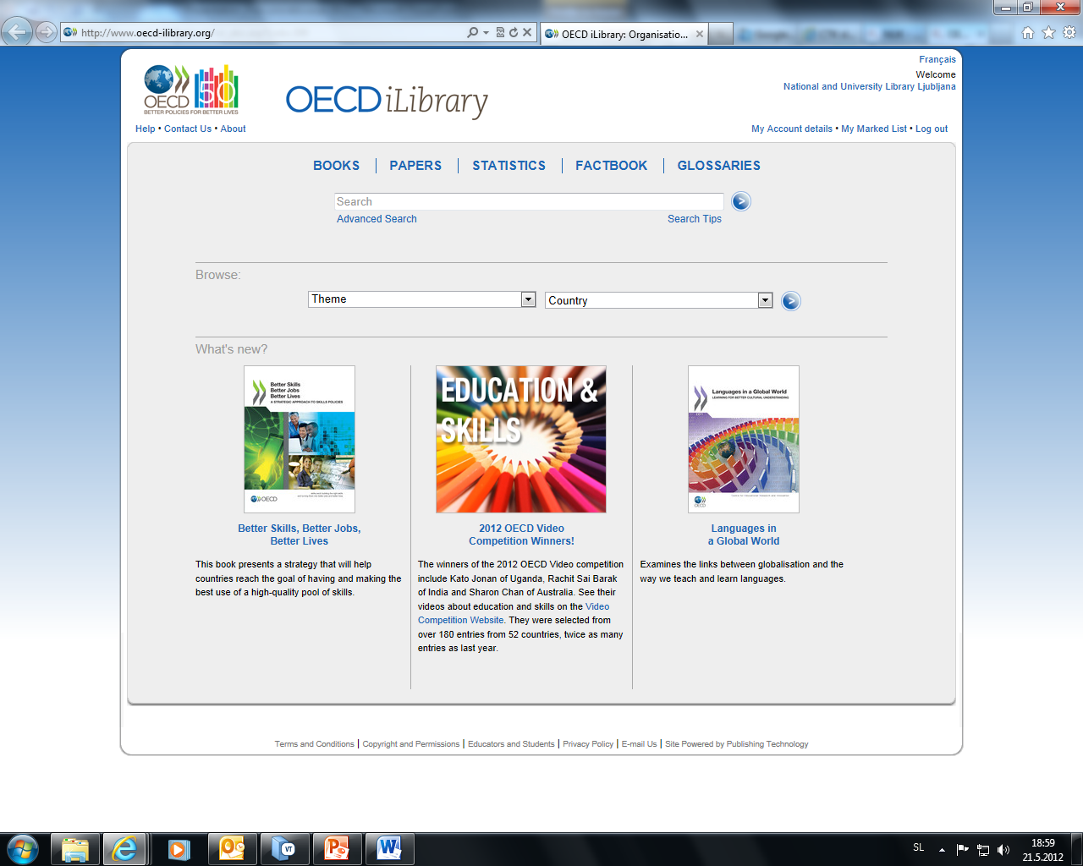
OECDiLibrary

Slide 19
OECDiLibrary
to the full content can be accessed from a location NUL and the University of Ljubljana and the Central Technical Library (specified IP),
we will start to negotiate to be fully accessed for the members of the library,
OECDiLibrary allow to search and read the full text of all publications issued by the OECD since 1998,
there are over 2000 books, reports, newspaper etc.,
also allows viewing of 26 OECD statistical databases and 10 databases IEA - International Energy Agency.

Slide 20
Publications of OECD – topics:
Banking,
taxes,
energy,
education,
agriculture,
makroeconomy,
migration,
direct investment,
environment and Sustainable Development,
telecommunication etc.

Slide 21
Information inquirys
Users can search the existing models and methods, through the OPAC, or through other information sources,
all publications of depozit librarys are in free access, ephemeral publications are in warehouse.

Slide 22
Specific examples of information inquiries
Elections 2011,
e-mail address of a person who works in the EU,
all of the European funds,
legal basis to ensure the health of drinking water (EU),
monitoring of drinking water systems,
economic data in some countrys (World Bank, OECD),
EU directive on specific topic,
education (OECD resarch),
Europe Direct points in Slovenia,
blacklist of banned airlines (EU),
etc.

Slide 23
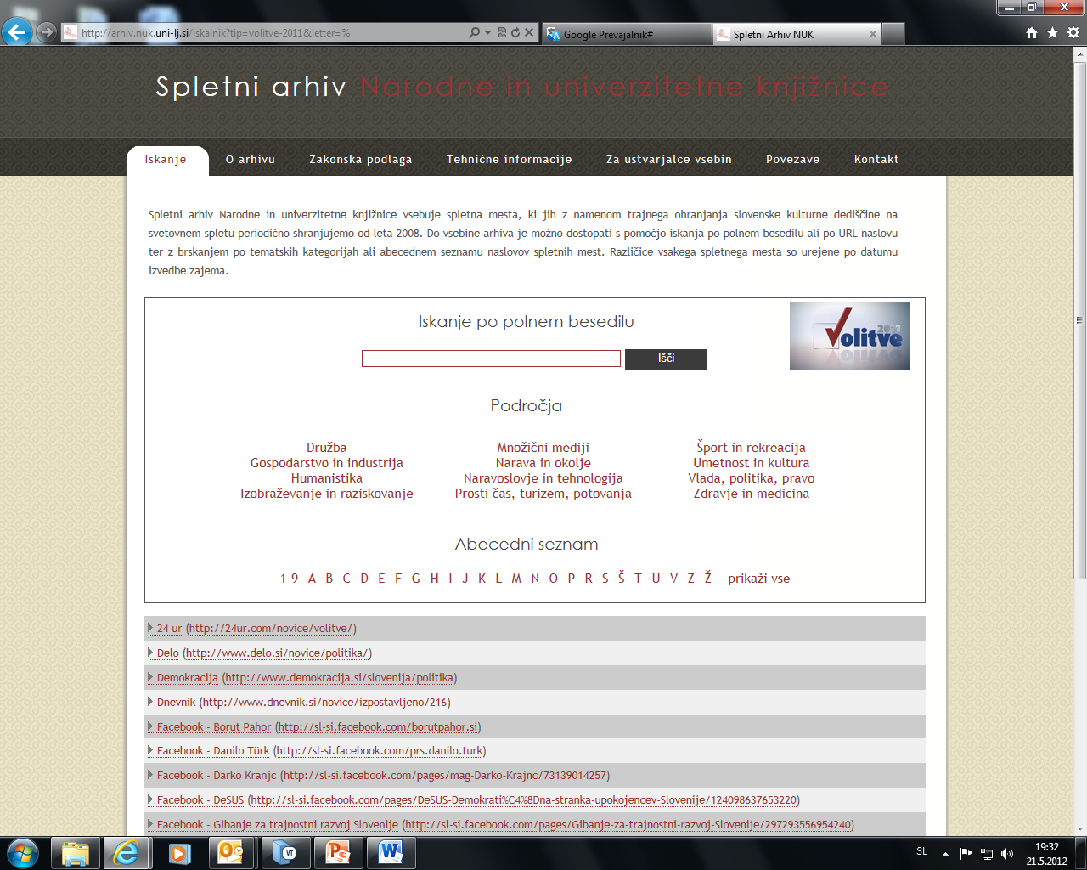
Web archive – new ephemeral on line publications

Slide 24
Cataloging – collection record (new way of cataloging)
Polje | Ind. | Podpolja
001 |  | an-nov zapis ba – tekstovno gradivo cc – zbirni zapis d0 – ni hierarhičnega odnosa 7ba – latinica
100 |  | bg – publikacija, ki izhaja več kot eno leto c2008 ek – odrasli, zahtevno (neleposlovje) hslv – slovenski lba - latinica
101 | 0 | aslv - slovenski
102 |  | asvn - Slovenija
200 | 1 | a[EuroGlobe projekt einformativno gradivo]
210 |  | aLjubljana cCenter Evrope d2008-
215 |  | a<5> enot
610 | 0 | ainformativno gradivo areklamno gradivo aevropski projekti aEuroGlobe
675 |  | a792 c792 – Gledališče, Gledališke predstave vUDCMRF 2006

Slide 25
Cataloguing - corporate headings
Polje | Ind. | Podpolja
001 |  | an – nov zapis ba – tekstovno gradivo, tiskano cm – monografska publikacija d0 – ni hierarhičnega odnosa 7ba - latinica
010 |  | a978-92-79-14042-6
017 |  | a10.2775/46311 2doi
022 |  | alux – Luksemburg bNA-30-09-224-FR-C
100 |  | bd – publikacija, zaključena ob izidu ali v enem koledarskem letu c2010 ek – odrasli, zahtevno (neleposlovje) ff- medvladna organizacija hslv – slovenski lba - latinica
101 | 1 | afre – francoski ceng - angleški
102 |  | alux - Luksemburg
105 |  | aa - ilustracije
200 | 1 | aL'Europe pour les femmes f[prépare] Union Européenne, [Direction générale de la communication]
210 |  | aLuxembourg cOffice des publications de l'Union européenne d2010
215 |  | a19 str. cilustr. d19 cm
300 |  | aIzv. stv. nasl.: Europe for women
500 | 1 0 | aEurope for women mfrancoski jezik
606 | 1 | aPravice žensk xPoložaj žensk xUdeležba žensk yEvropska unija 2EUROVOCS
675 |  | a308(061.1EU) vUDCMRF 2006 c308 – Sociografija. Opisane študije družbe. Družbene razmere
712 | 0 2 | aEvropska unija bEvropska komisija bGeneralni direktorat za komuniciranje 601
912 | 0 2 | aUnion européenne bCommission européenne bDirection générale de la communication 601
 |  | Postavitev: EU 005 1645

Slide 26
Cataloguing - corporate headings
when choosing a „normative“ (authority headings) headings for corporate preferred form of the name, which is in its publications,
when the variant forms of the abbreviation or acronym we use the name in full form (Organisation for Economic Co-operation and Development, Evropska unija, International Labour Organization),
unless it is an acronym or an abbreviation often used (UNESCO).

Slide 27
Memoria Scripta Sloveniae
Is Slovenian project about written cultural heritage,
the Collection PKG and international organizations have also very rich stock of so callled „club records“ (društveni spisi) – they are: collective agreements, operating results, statutes, directories of members, election timetables, electoral commissions, newsletters, minutes of meetings, political speeches, community publications etc.
accessible through the card catalogs,
under the Europeana we are planing to digitize these important documents.

Slide 28
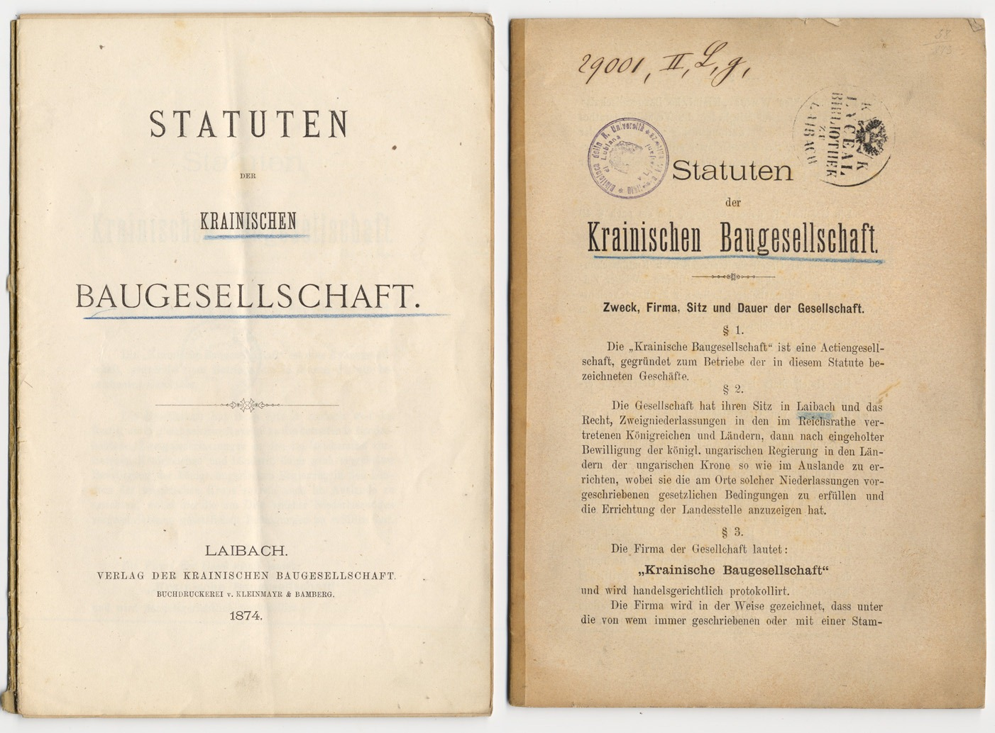
Memoria Scripta Sloveniae

Slide 29
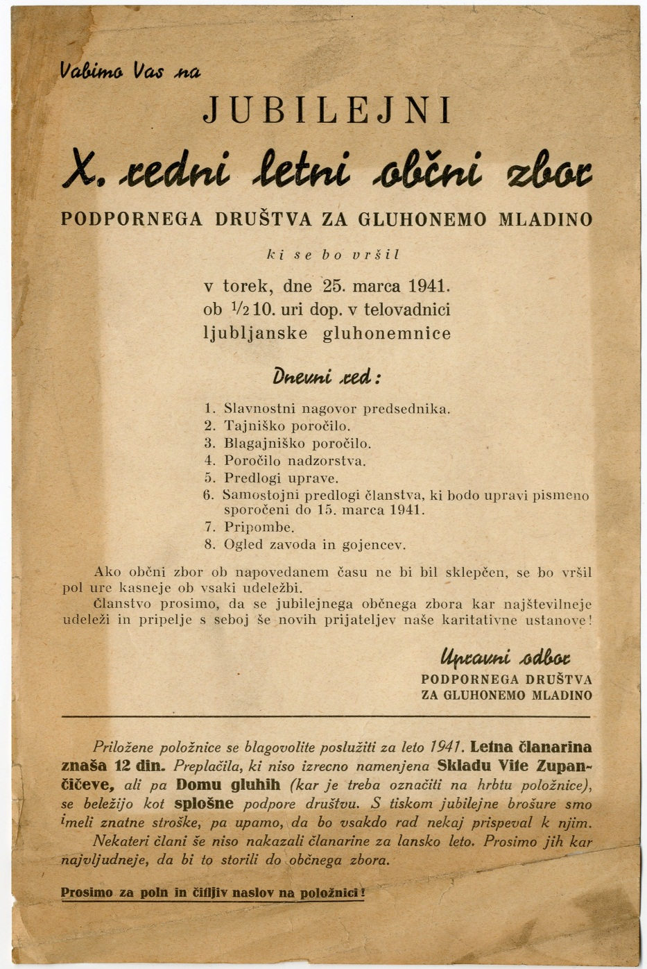

Memoria Scripta Sloveniae

Slide 30
Library of Congress
Publications are produced by the exchange,
a lot of government official publications,
they are placed in Collection PKG and internatonal organizations (in warehouse),
to name a few international organizations which we receive by the excange: U. S. Governement Printing Office (president speeches etc.), International Monetary Fund, International Trade Center, United Nations, The World Bank etc.

Slide 31
Conclusion
In strategic plan of the NUL for the period 2010 - 2013 the preferential policies is the preservation of Slovenian written cultural and scientific heritage – so priority in Collection PKG and international organizations is ephemeral slovenian print,
some publications of international organizations and the fine print may be related to the concept of gray literature,
this will be our field of research in the future.

Slide 32

THANK YOU VERY MUCH FOR YOUR ATTENTION

