Slide 1

Testing and Evaluation in Digital Preservation Projects: the case of KEEP
Milena Dobreva
Janet Delve, David Anderson, Leo Konstantelos

Slide 2
  OVERVIEW
  Challenges in evaluation for DP
  Initial scoping study: emulation in memory institutions (based on experience of BnF, KB, DNB, CSM)
  Future steps
Notes:
6.7.2009
2

Slide 3
  EVALUATION AND TESTING IN DP
  Paradox 1 – testing for DP systems needs to demonstrate their sustainability over time... But we still do not know how to do this and test DP systems as repositories.
  Paradox 2 – systems which actually should meet the needs of FUTURE users.
Notes:
6.7.2009
3

Slide 4
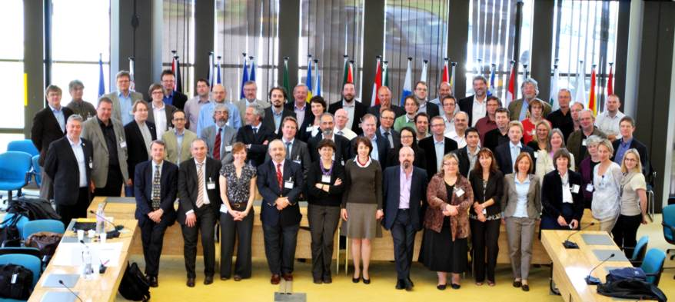
Workshop “The Future of the Past” –
The future of Digital Preservation Research Programmes
Organised by The Information Society and Media Directorate General
of the European Commission, Luxembourg, 4 – 5 May 2011

Slide 5
  KEY TOPICS DISCUSSED
Extraction of Preservation Information
Integrated access – Time – Systems - Community
Reformulate Digital Preservation as a computer science question
Integrated emulation systems
Knowledge Preservation
Quality Assessment
Complex Objects
Automation
Ease of use and private data
Integration of Digital Preservation into Digital Asset Management
Standards
Market-Driven and Cost Benefit
Self-Preserving Objects

Slide 6
  PLACE OF EVALUATION/TESTING
Type | What is it used for?
Front-end involvement | Users can take part in assessment on a variety of technical requirements or exploratory research, e.g. needs in new services and defining requirements.
Normative evaluation and testing | This type of evaluation usually takes form of iterative circles of process-and-evaluation when implementing DP systems. Most typically such evaluation will focus on usability.
Summative evaluation | Here the focus is the final output and the accordance to the expectations and requirements of target communities/organisation structures/the wider disciplinary domain.
Direct engagement in the digital resource creation | Direct user engagement can utilise social media tools which allow users to contribute their own digital objects or to take part in the enrichment of resources – e.g. supplying full texts, or metadata.

Slide 7
  WHAT DOES IT MEAN IN KEEP?
Type | What is it used for?
Front-end involvement | Scoping study of experience in 3 national libraries and one museum. Informed the development of the emulation platform.
Normative evaluation and testing | Currently being planned.
Summative evaluation | Would be done when the emulation platform is released with the participation of key players such as BL, OPF, DCC, DPC.
Direct engagement in the digital resource creation | Crowdsourcing for data on the emulator knowledge base is being considered.

Slide 8
  The front-end evaluation
  Different libraries are legal depots for different types of material
    BnF – phonograms (1938), video and multimedia (1975), audio visual and electronic documents (1992), web (2006); computer games.
    DNB – web (2006), digital publications (voluntary basis). No games - preserved by CSM.
    KB – Dutch imprints (1974), scientific applications.
Notes:
6.7.2009
8

Slide 9
  Preservation systems in use/under development
  BNF – SPAR (Distributed Archiving and Preservation System) under development, OAIS complient; open source; grid; link to Gallica
  KB – eDepot (IBM DIAS) with a specific workflow
  DNM – kopal-DIAS, koLibRi, Daffodil (information retrieval) – partnerships with SUB Goettingen, IBM; own format for preservation metadata LMER
Notes:
6.7.2009
9

Slide 10
  Summary
  For all institutions preservation is part of their mandate
  Various tools/metadata standards
  Various key partnerships
  Key issue – how to integrate new tools when some already exist and are being users? What new tools are needed?
    Emulation is needed for software – including computer games
    KEEP works on a solution which includes a knowledge base on hardware and software platforms
Notes:
6.7.2009
10

Slide 11
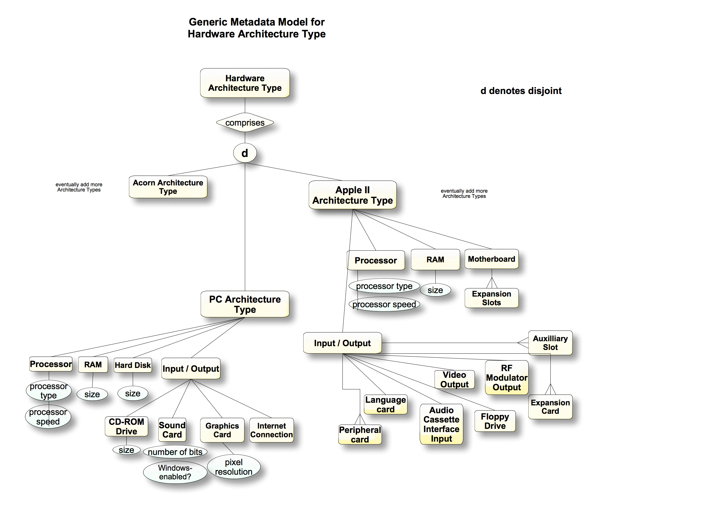

Slide 12
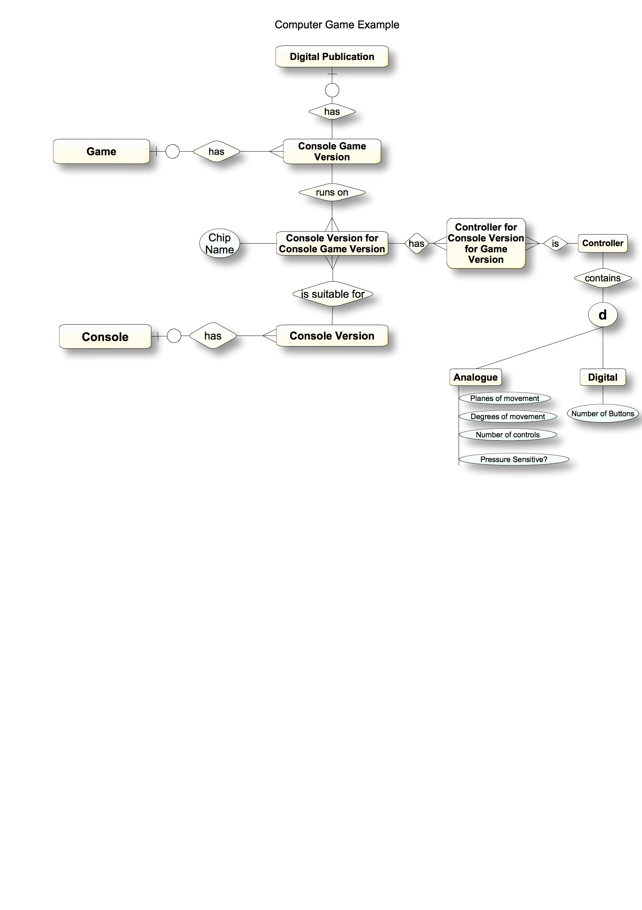

Slide 13
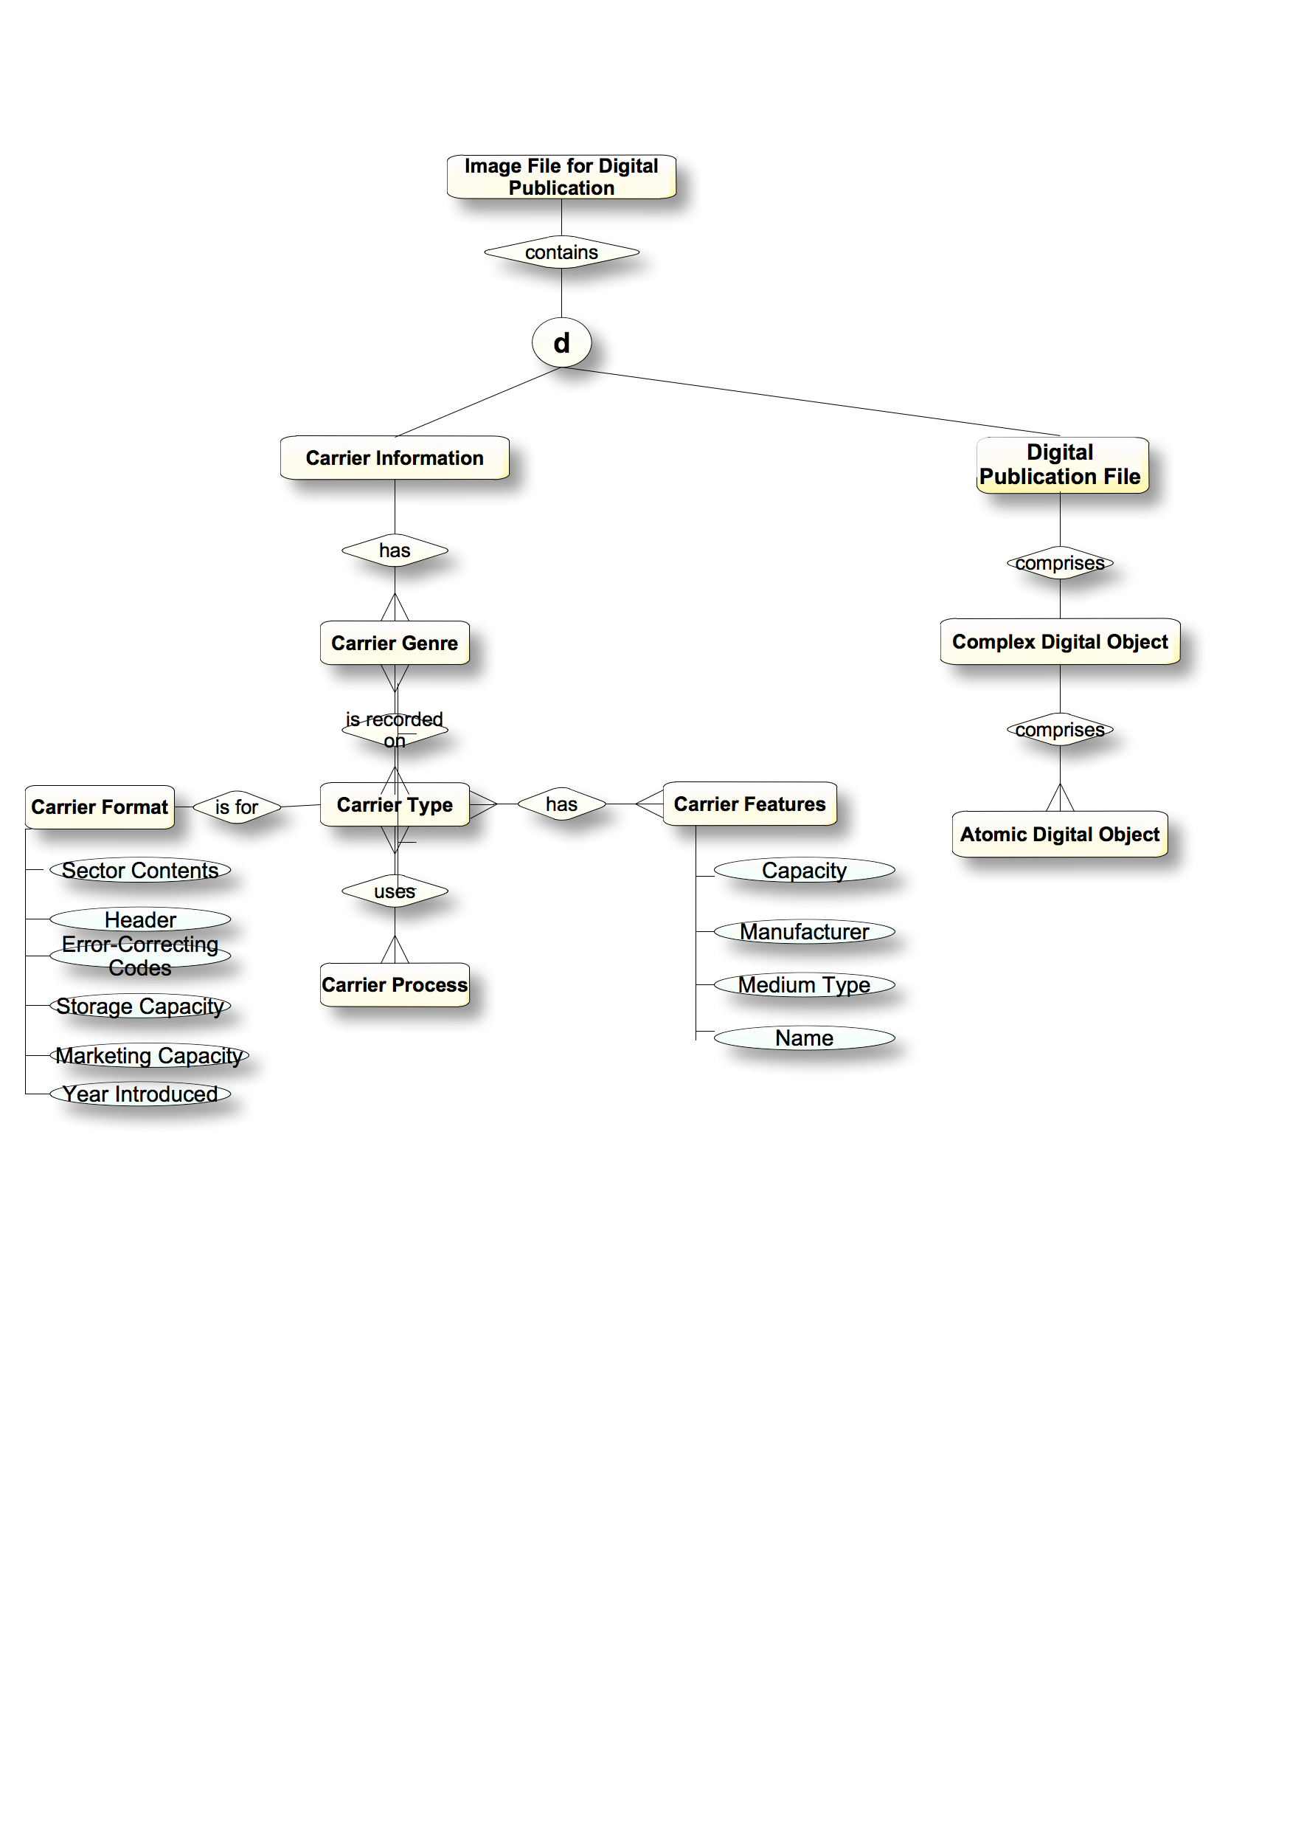

Slide 14
  The future
  Formative evaluation
    Testing of database components
    Use cases
    Within the consortium
  Summative evaluation
    Involving key bodies from outside
    Will inform dissemination
  Crowdsourcing pilot
Notes:
6.7.2009
14

Slide 15

Comments welcome…
Notes:
6.7.2009
15

