Slide 1
Digitization and Beyond:
Infrastructures for Digitized Resources
Malte Dreyer

Slide 2
The Max Planck Society
(MPG – Max-Planck Gesellschaft)
80 institutes
  Staff: ~ 21,000
Intense cooperation with universities

Slide 3
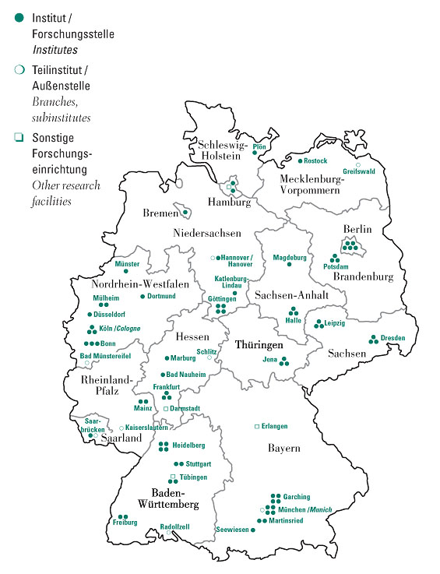
Locations
distributed organization
cooperation between different locations is very common
locations outside Germany are not shown (Nijmegen, Florence, Rome, …)
Notes:
2

Slide 4
Fields
diverse set of fields
  Chemistry, Physics, Technology
  Biology, Medicine, Brain Science
  Law, Art, History, Cognition
not a broad as many universities
but more interdisciplinary

Slide 5
Max Planck Digital Library MPDL
“To help researchers manage their scientific information workflows”
Founded in 2007
Departments
  Information Provision
  Research and Development
  Open Access
Complemented by activities in many institutes

Slide 6
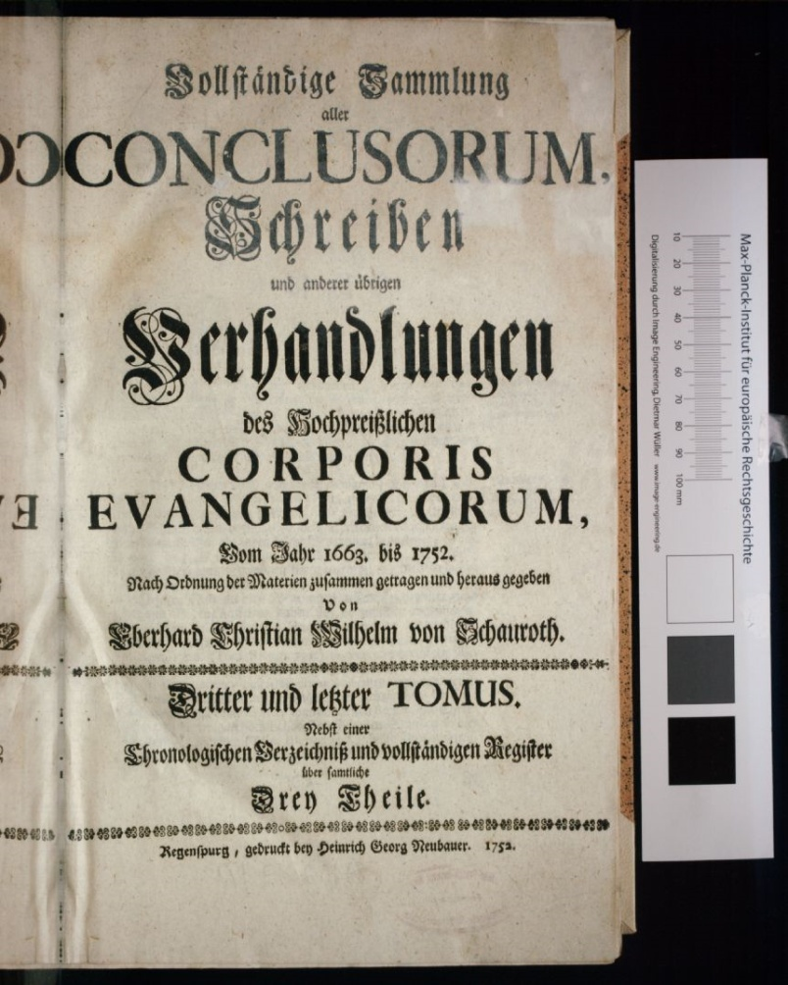
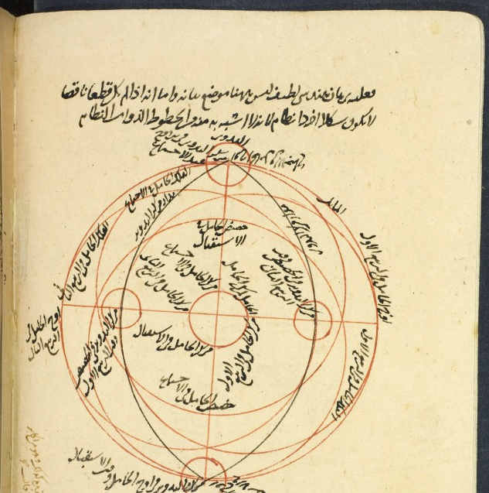
Digitized Resources: Images

Slide 7
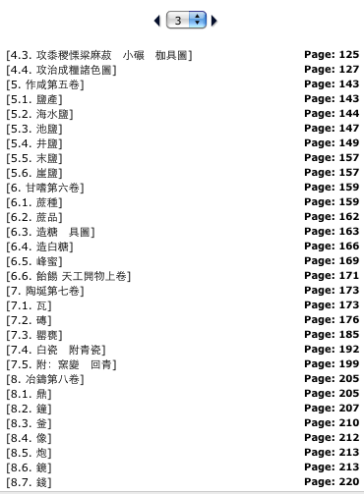
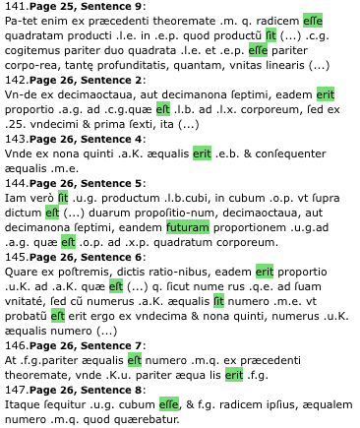
Digitized Resources: Texts

Slide 8
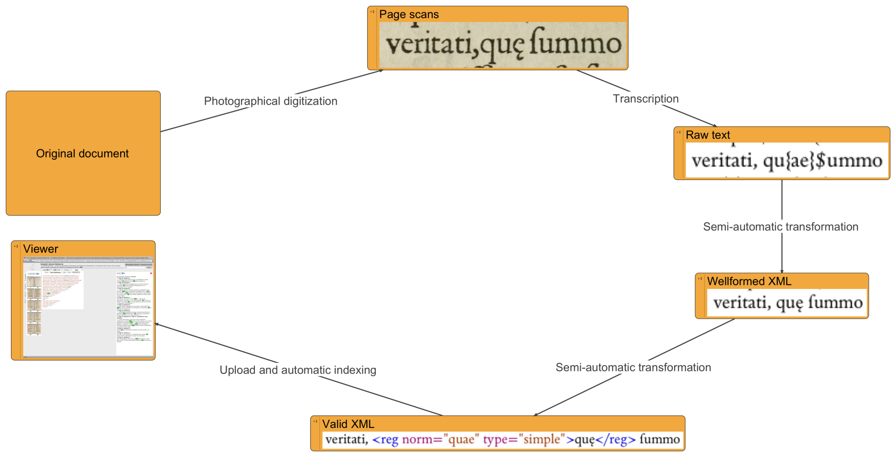
Digitized Resources: Natural Language Processing

Slide 9
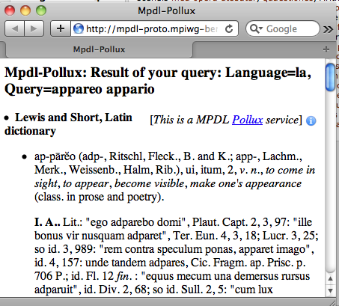
Digitized Resources: Dictionaries

Slide 10
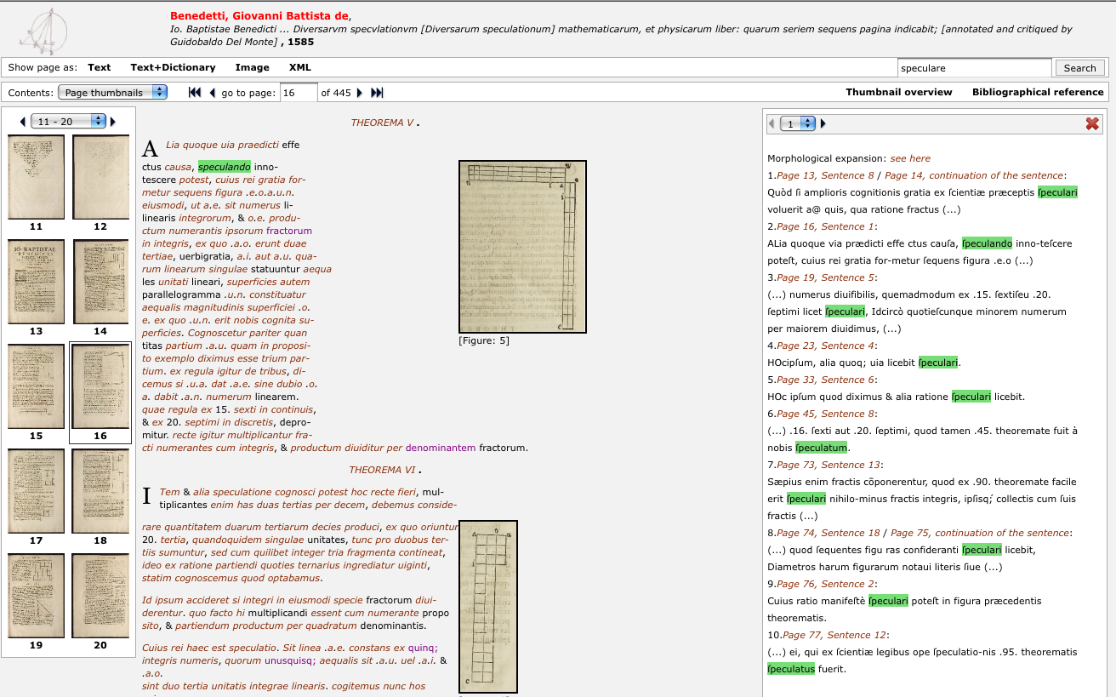
Digitized Resources: Tools and Infrastructure

Slide 11
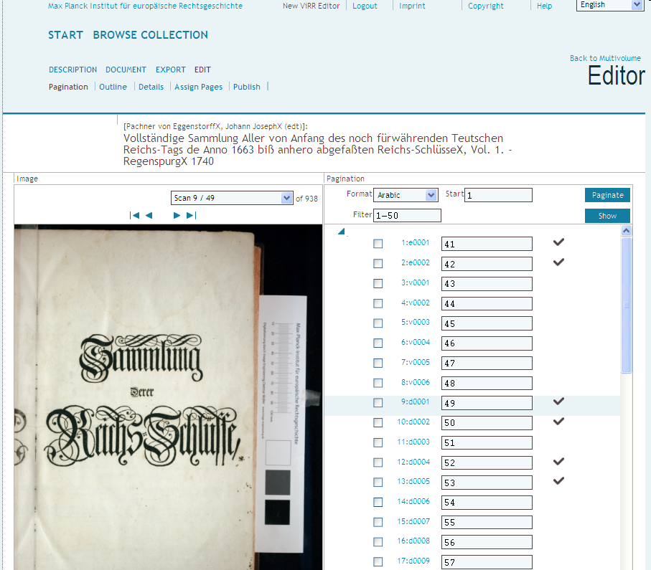
Tools for Management and Editing of Objects

Slide 12
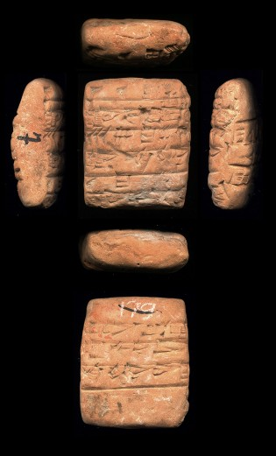
Research Data: Network of Interrelated Objects
Metadata
Annotation
Transcription
Metadata
Translation
Metadata
Annotation
© Institut Catholique, Paris, France

Slide 13
Talking about Tools and Research Data
means talking about Infrastructure

Slide 14
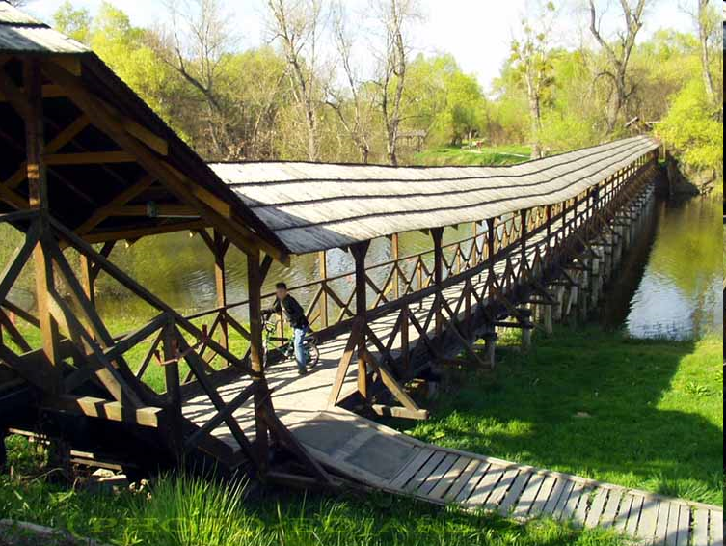
Infrastructure /1: Fixed Purpose
http://commons.wikimedia.org/wiki/File:DA_ph_dreveny_most01.jpg (CC-By-SA 3.0)

Slide 15
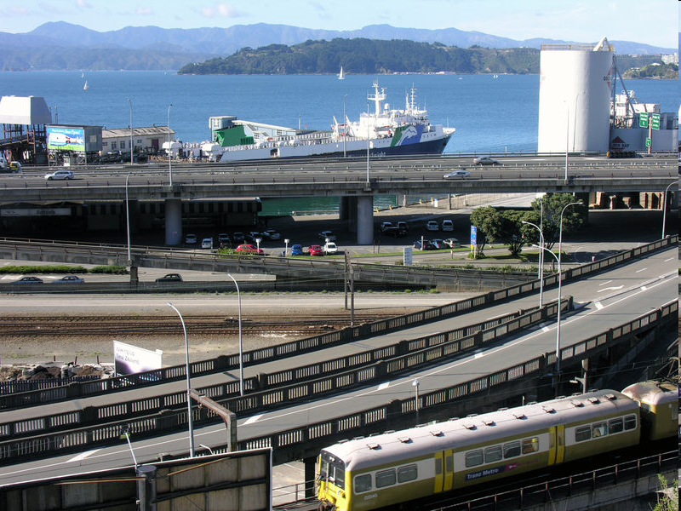
Infrastructure /2: More flexible
http://commons.wikimedia.org/wiki/File:Wellington_infrastructure.jpg (CC-By 2.0)

Slide 16
As a eResearch Infrastructure
Connecting
People
Contents
Tools
Services/Machines
http://commons.wikimedia.org/wiki/File:Wellington_infrastructure.jpg (CC-By 2.0)

Slide 17
Infrastructure Activities: Examples
Germany
  eSciDoc: www.escidoc.org
  Textgrid: www.textgrid.de
Europe:
  Dariah: www.dariah.eu

Slide 18

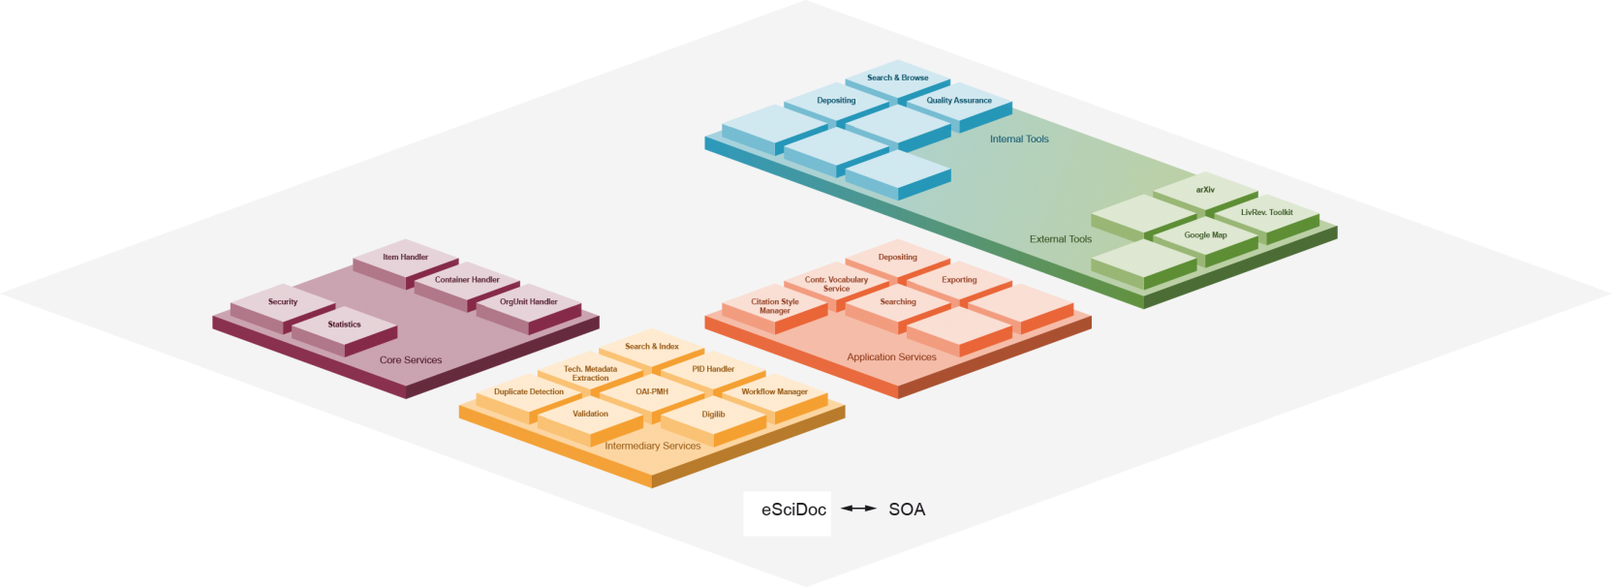


Open Source
Modular
Growing Community
Sustainable
Infrastructure
and
Applications
Cross-Disciplinary
Also used within

Slide 19
eSciDoc is…
An eResearch Infrastructure
A Repository Infrastructure
An Infrastructure for Virtual Research Environments
A Publication Infrastructure
A Set of Services, Tools and Content Models
An Archive
A Growing Set of Applications:
  Publication Management
  Digitized Resources and their Lifecycle
  Image Research Data and their Specifics
  Electronic Laboratory Journals (Upcoming)
  TEI Repository
  Astronomer‘s Workbench (Community of Practice Platform)

Slide 21
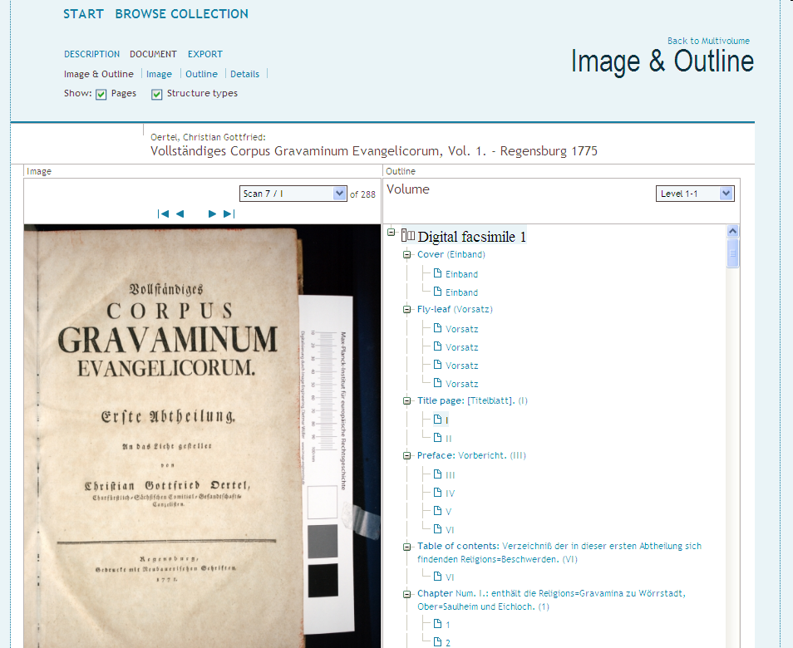

Slide 22
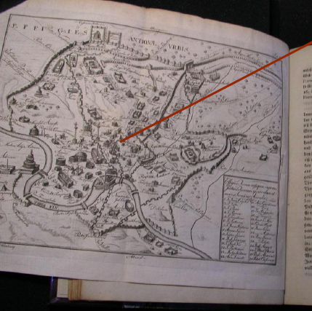
Describing Streetmaps

Slide 23
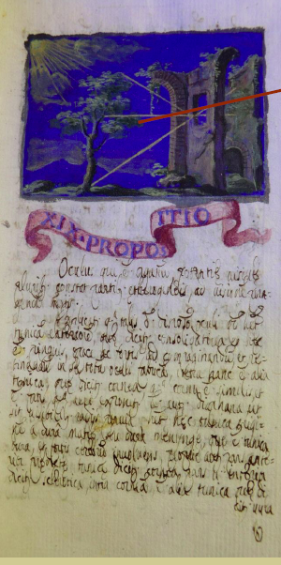
Iconographic Descriptions

Slide 24
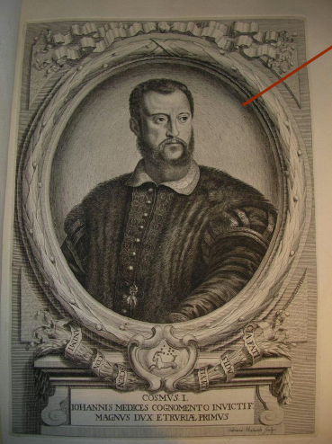
Linking Persons to Authority Data

Slide 25
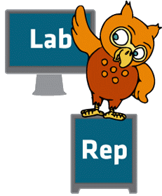
TextGrid: The Virtual Research Environment
TextGrid Laboratory
  single point of entry to the virtual research environment
  provides integrated access to both new and existing tools and services via user-friendly software
  will be updated continously with beta tests
TextGrid Repository
  long-term archive for research data in a grid infrastructure
  ensures long-term availability and access to its research data as well as interoperability
Notes:
The TextGrid virtual research environment consists of two main components: the TextGrid Lab(oratory), which serves as the entry point to the virtual research environment, and the TextGrid Rep(ository), which is a long-term humanities data archive ensuring sustainability, interoperability and long-term access to research data. To support all stages of the research process, preserve and maintain research data and ensure its long-term usefulness, existing research practices must be supported. Therefore the TextGridLab provides common functionalities in a sustainable environment to intensify re-use of data, tools and services and the TextGridRep enables researchers to publish and share their data in a way that supports long-term availability and reusability.
After five years of research and development, TextGrid will release a stable, operational version 1.0 in July 2011.
First, we would like to give you an overview of the tools that TextGrid provides for text based research.

Slide 26

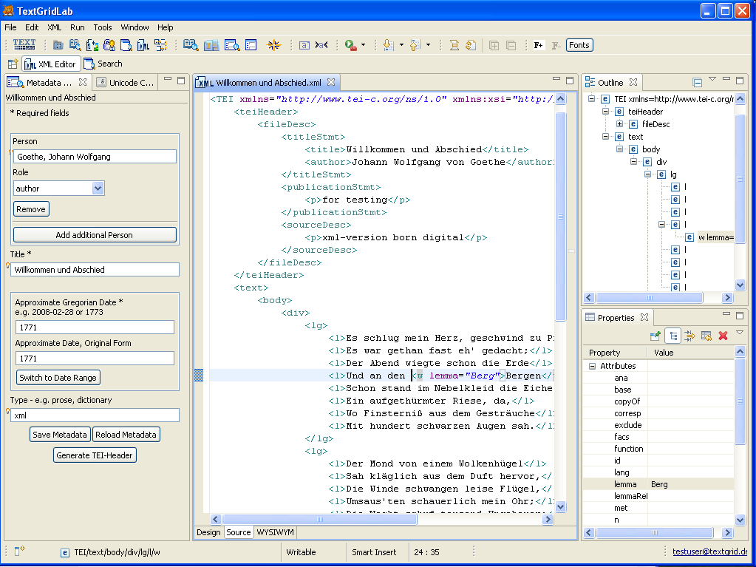
XML Editor
Notes:
The XML editor, with which users can switch easily between a more technical view with tags and attributes and a structural view that is oriented towards standard text editing applications. A Unicode Character Table enables the user to search, copy and insert symbols from the Unicode character set.

Slide 27

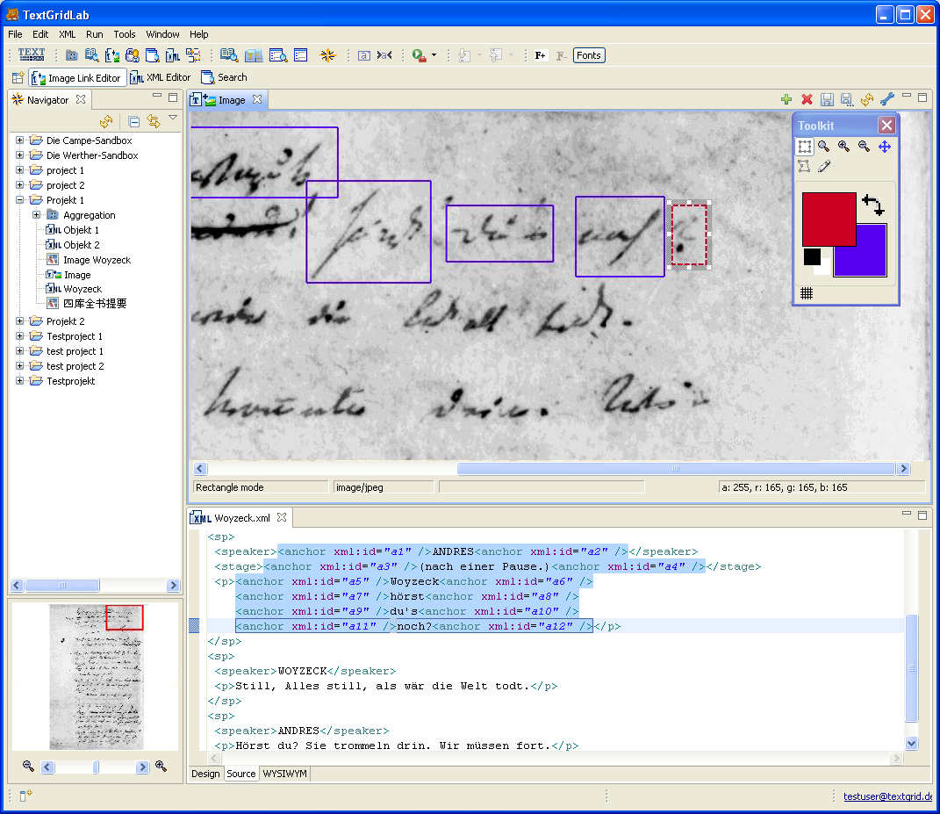
Text-Image-Link Editor
Notes:
The Text-Image-Link editor supports the XML Editor by linking text sequences with image sections in order to create files that contain text elements and topographic descriptions.

Slide 28
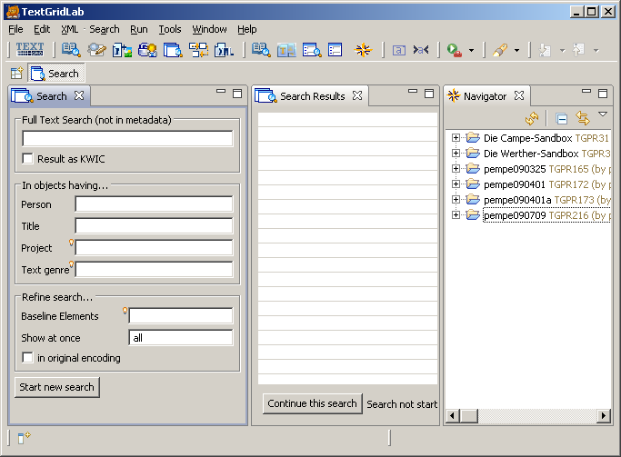
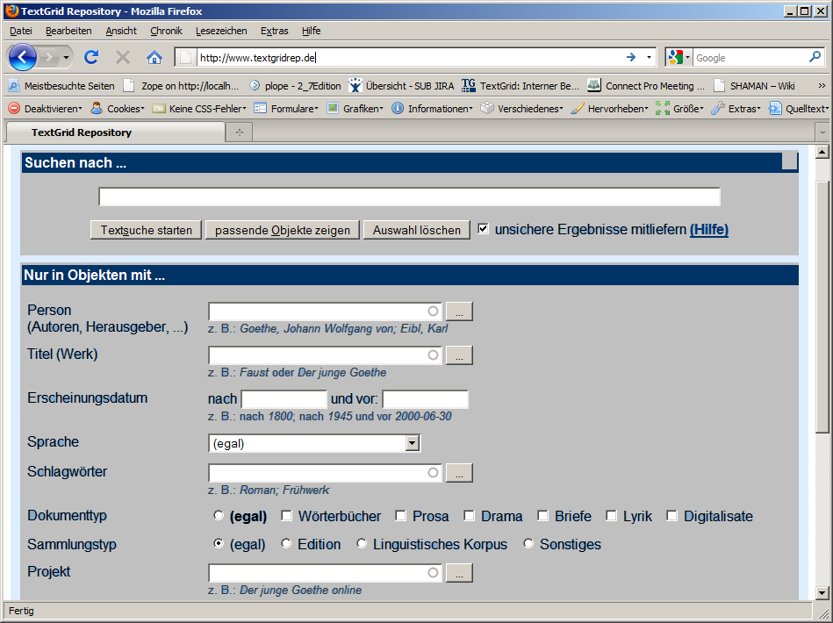
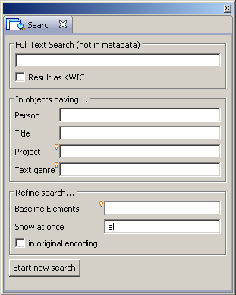
What’s the Grid in TextGrid? – Storage!
Eclipse Frontend
Portal(s)
TextGridLab
open interface
specific portals
Ingest
1
huge amounts of data
individually adaptable
rights management
Ingest 2
TG-publish
search
index 1
TG-publish
search
Index 2
TextGridRep
TG-auth*
+ metadata validation /QA
+ Persistent Identifier
+ (LTP MD)
+ (LTP services)
+ (metadata validation)
+ (persistent identifier)
+ (LTP MD + services)
Grid Storage
dynamic
static
LTP
Notes:
On a basic level TextGrid will offer bitstream preservation with redundant grid storage and tape backup for 10 years (as recommended in the guidelines of the German Research Foundation[1]). Long-term bitstream preservation and higher security levels such as further distributed storage on multiple sites will be available at greater cost in the future. Please, have a closer look at the publishing process at the slide. When researchers publish their research data via the TextGridLab in the repository, the metadata provided will be automatically validated. All data will be addressable via persistent identifiers that TextGrid will allocate by using a reliable handle service that is provided by the local data centre, which is a main developing partner in European Persistent Identifier Consortium as well as the computer centre for the Max Planck Society. As part of the publishing process the data will be frozen and moved to a static storage cluster used for long-term preservation. Of course people want to access the public data without using TextGridLab. Therefore a portal solution will enable rapid searching across public research data via a second search index without connection to the rights management (TG-auth*). An open REST interface for individual portal solutions will be provided, so research groups may provide specific elaborated access to their research collections. Archives and other institutions can ingest bigger amounts of data into the repository via a special interface that uses koLibRI, which supports automatic metadata validation, for example.
Higher-value long-term preservation services will be provided within the next year by making use of developments within the WissGrid project. A joint venture of the academic community grids that participated in the German Grid Initiative, WissGrid consists of high-energy physics, astronomy, medicine, climate research, and the arts and humanities. It aims to develop an operational model for academic grid users, create blueprints for new academic community grids (such as social sciences), and foster long-term storage for research data. The project is developing a service framework that fulfils more sophisticated long-term preservation needs like a provenance service, metadata extraction, format validation and conversion. Guidelines will be adapted to the specific needs of the humanities and be incorporated in the TextGrid virtual research environment. The grid storage and all connected resources will be maintained together with the other academic disciplines at the common grid resource centre in Göttingen (at the moment there are 275 terabytes for the humanities).
[1] Proposals for Safeguarding Good Scientific Practice (http://www.dfg.de/download/pdf/foerderung/rechtliche_rahmenbedingungen/gute_wissenschaftliche_praxis/self_regulation_98.pdf)

Slide 29
    ESFRI Project
    Partners:
    Croatia
    France
    Germany
    Greece
    Ireland
    Netherlands
    Slovenia
Karolj Skala from
Ruđer Bošković Institute

Slide 30
Virtal Competency Centres – VCCs
VCC1 e-Infrastructure
  … to establish a shared technology platform for A+H research.
VCC2 Research and Education
  … to expose and share researcher's knowledge, methodologies and expertise.
VCC3 Scholarly Content Management
  ... to expose and share scholarly content.
VCC4 Advocacy, Outreach, and Impact
  ... to interface to key influencers in/for A+H.

Slide 31
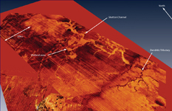
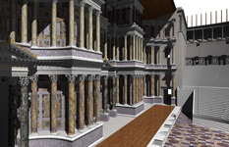
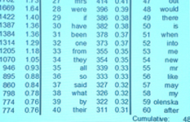

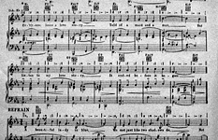
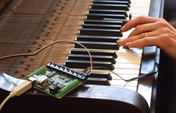
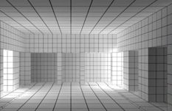
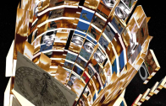
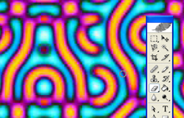
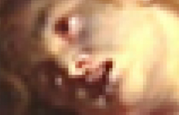
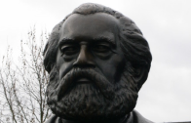

Disciplines
Archaeology
History
Language
Literature
Music
Performance
Media
Information
Visual Arts
Religion
Philosophy
Law
http://www.nesc.ac.uk/talks/968/reimer_ahnet.ppt

Slide 32
End
Thanks for your Attention !

