Slide 1
Behind Rockovnik
Jelena Hadži-Purić
Dušan Vesić
Sandra Rančić
Jasmina Dobrić
Faculty of Mathematics, Belgrade

Slide 2
Introduction
Behind Rockovnik is digitization project
based on Rockovnik (i.e. Rock diary).
Rockovnik is TV show dedicated to the
history of rock music in former Yugoslavia
from 1958-2000.

Slide 3
Authors and their (divergent?) background knowledge :
Dušan Vesić (historian, journalist) | Jelena Hadži-Purić (mathematician, software developer)
Sandra Rančić (journalist) | Jasmina Dobrić (mathematician, network administrator)

Slide 4
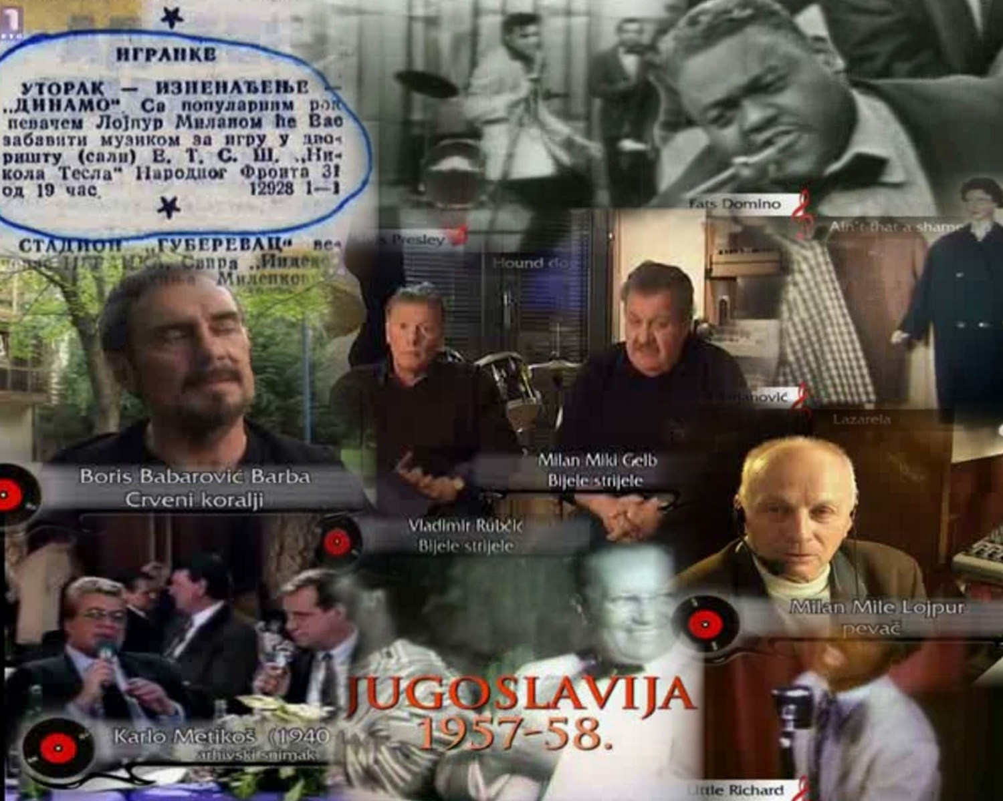
Notes:
It starts with the first appearance of that sort of music by the mid 1950s (Mile Lojpur, Karlo Metikos)
and beginning of the 1960s (Siluete, Bijele strijele, Crveni koralji)

Slide 5
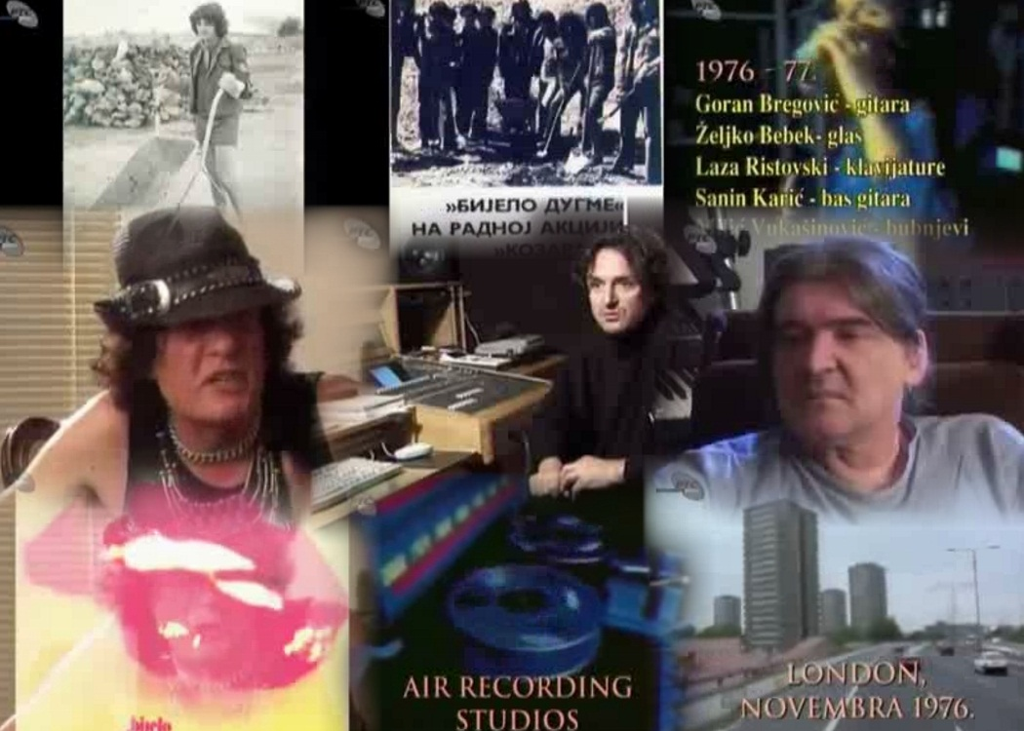
Digital collection of songs, album covers, articles, TV interviews, important locations,...

Slide 6
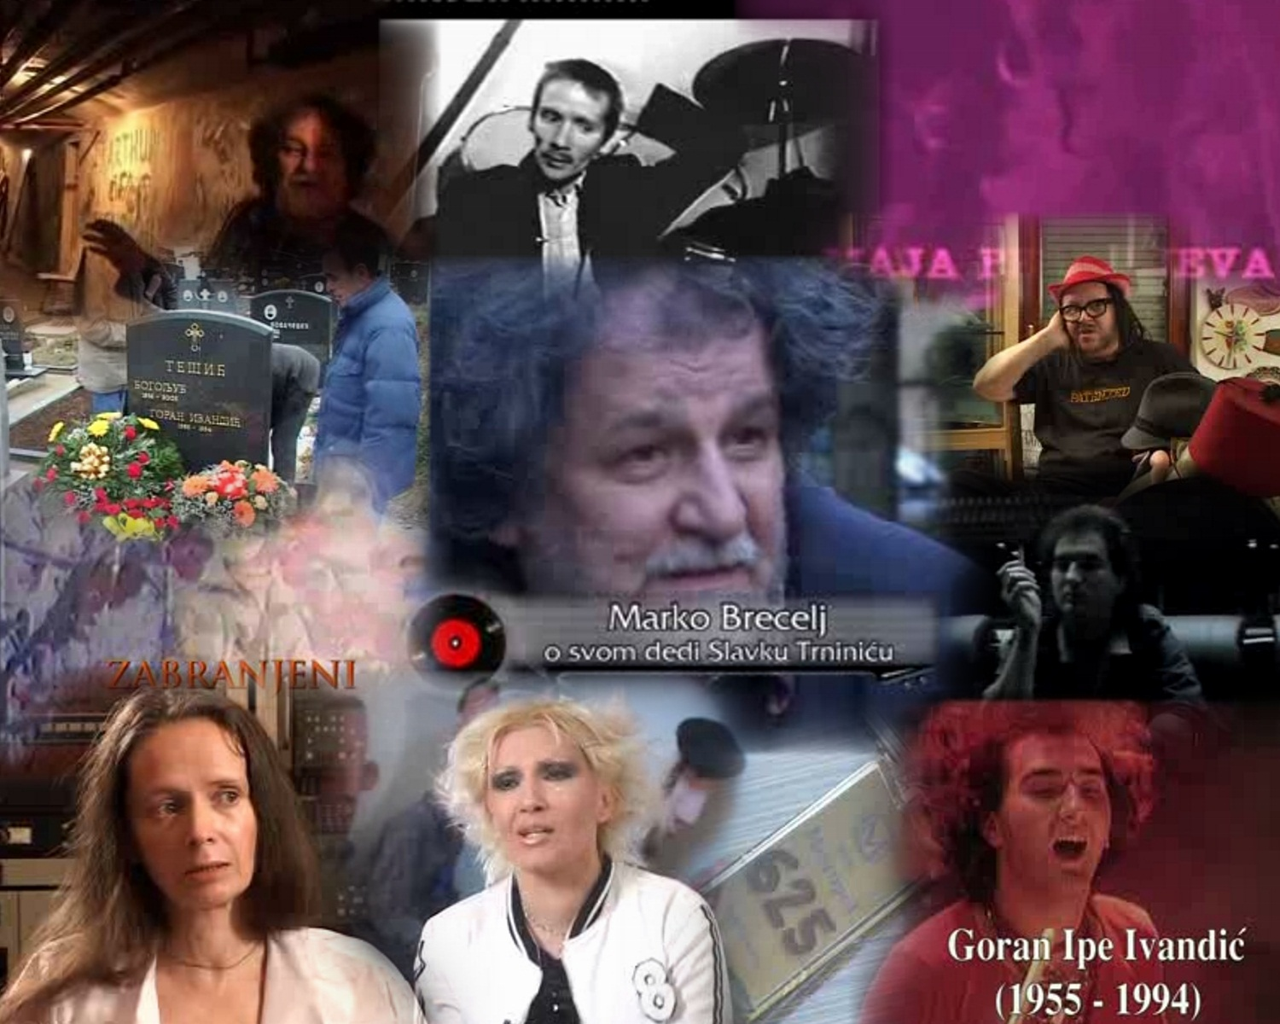
Much more, Rockovnik contains number of unpublished audio and video recordings and stories from the archives of RTS (Radio Television of Serbia), Croatia Records and from private collections

Slide 7
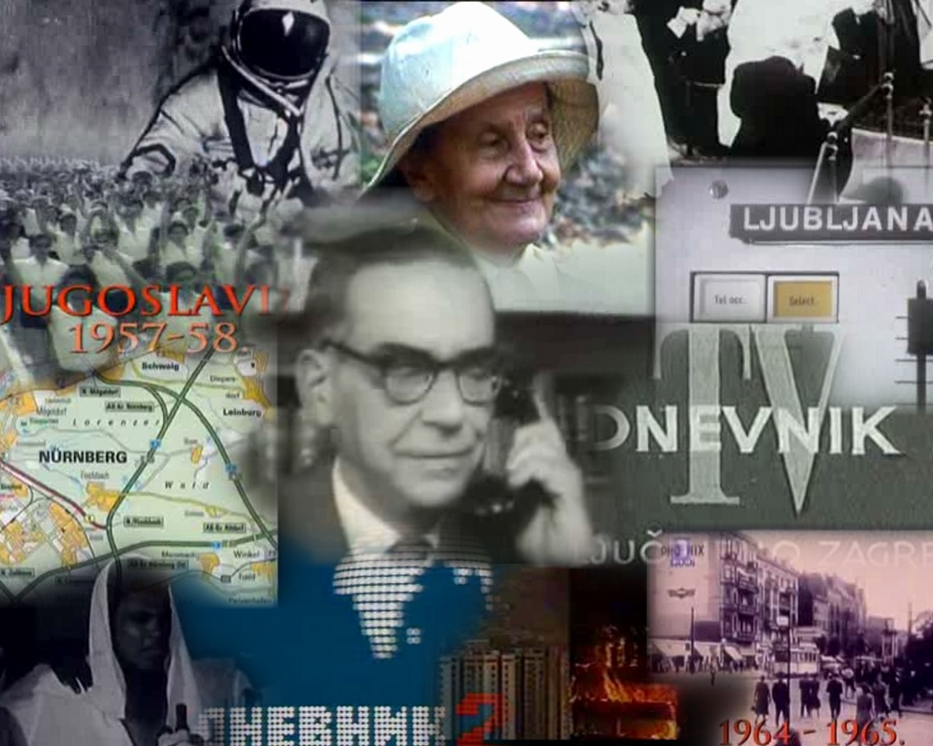
Much more, the pages of this diary contain stories about influence, causes and effects of historical events in former Yugoslavia and abroad (1958-2000).

Slide 8
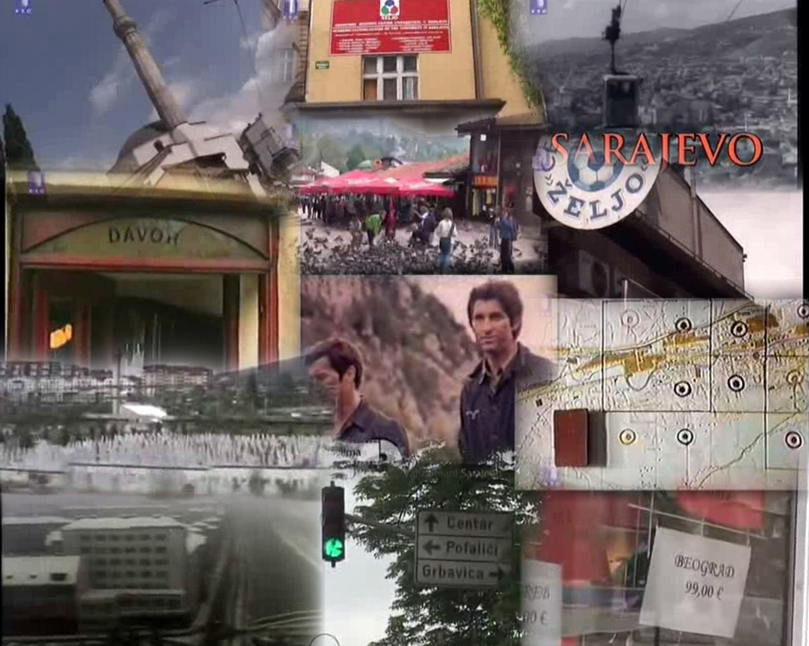
Much more, the Rockovnik contains pictures and stories from important rock centers: Beograd, Zagreb, Sarajevo, Kragujevac, Pula, Rijeka, Ljubljana, Novi Sad i Skoplje

Slide 9
Behind Rockovnik: main activities since 1999
Digitization (long lasting, pilot project since 1999)
Storage and presentation(2005-...)
Retrieval

Slide 10
The most complex steps
Gathering material (since 1993)
Providing sponsors (since 2000)
Digitization (since 2004)
Processing digitized content

Slide 11
Behind Rockovnik: storage, presentation and retrieval
Multimedia data base and web-based user interface: www.rockovnik.com
Legal status: Public
Availability: Free
We are proud that part of material presented as TV show Rockovnik on RTS (Radio Television of Serbia) from April 2010 till March 2011.

Slide 12
Translation and Access
Access type:On line
Language:
1. English language
2. non-English-speaking audience access to the web site via Serbian language

Slide 13
Information retrieval
Our database is searchable by:
1. multimedia types (i.e. text, audio, video, picture)
2. subtypes (i.e. song, biography, album cover)
3. locations (i.e. Zagreb, Pula, Rijeka, Beograd, Kragujevac,...)
4. period (1957-1958, 1961-1963, 1991,...)
5. keywords

Slide 14
Search: fast and precise
Search enhancement is provided : when user type keywords, even when he doesn’t know exactly what he is looking for, predictions help him to guide his search.
Example: Z a g r e b
The top prediction is shown in grey text under the search box
Also, it is possible to stop typing as soon as user see what he needs.
Also, it is possible to reject search prediction

Slide 15
Quantity (may 2011)
10.2 GB of data in database, 5084 items
2274 Pictures of:
  Portraits (More then 300 participants)
  Performances
  Album cover
  Poster
  Ticket
  Other

Slide 16
Quantity (may 2011)
284 minutes of audio recordings
  songs
  radio and concert announcement
  Other
More than 20 hours of video recording
  Excerpt from Rockovnik interview
  Performance
  Documentary movies
  Other

Slide 17
Challenges and difficulties
Expensive project, particularly because
lot of material is located all round the world
70% gathered from private archive
Private collections from abroad: Sydney, Paris, Amsterdam,...

Slide 18
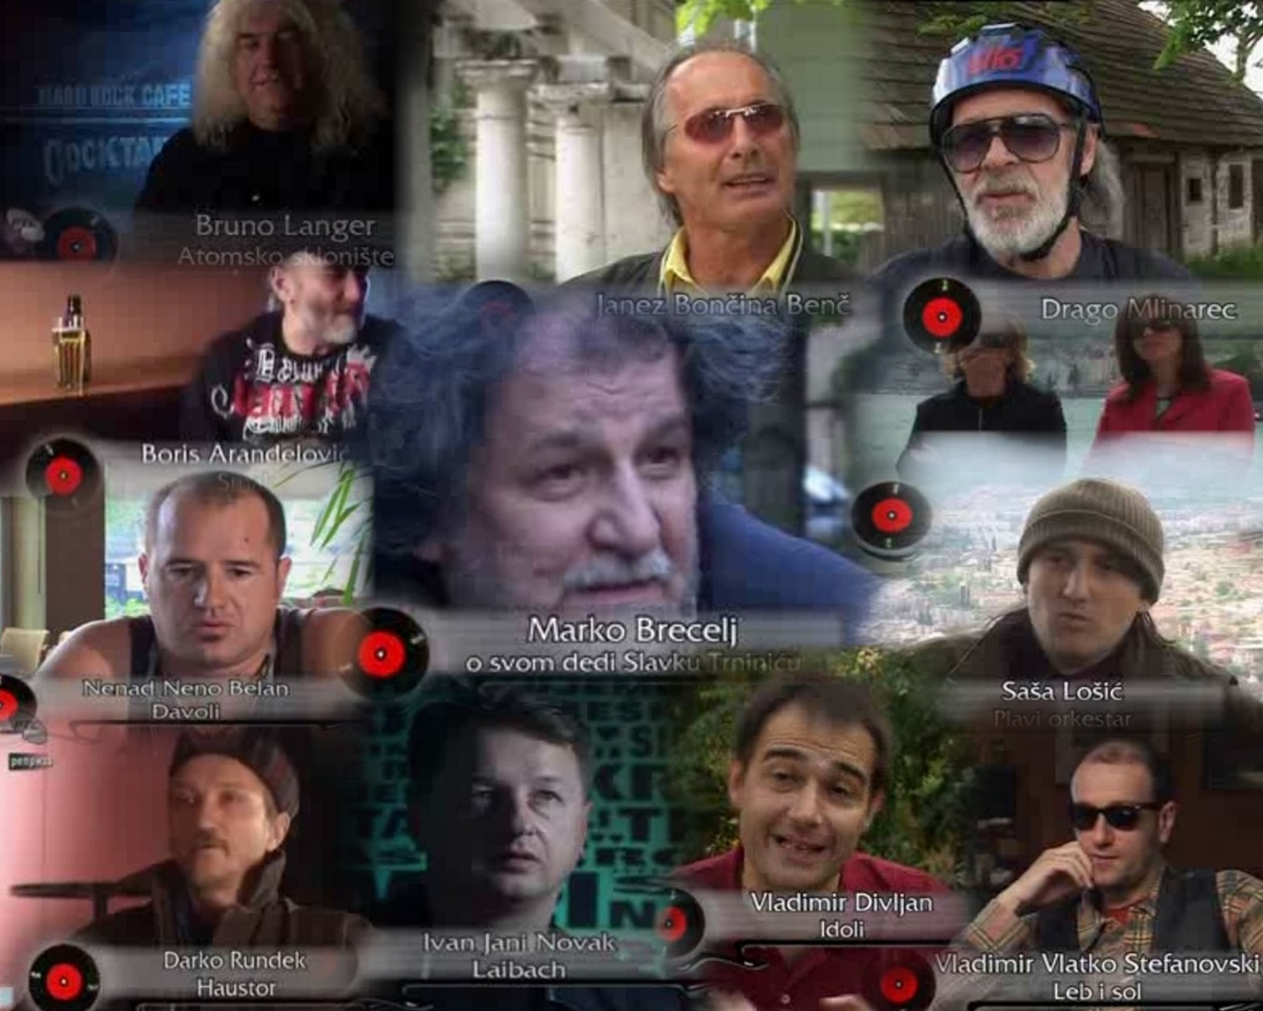
Contributors: all round the World

Slide 19
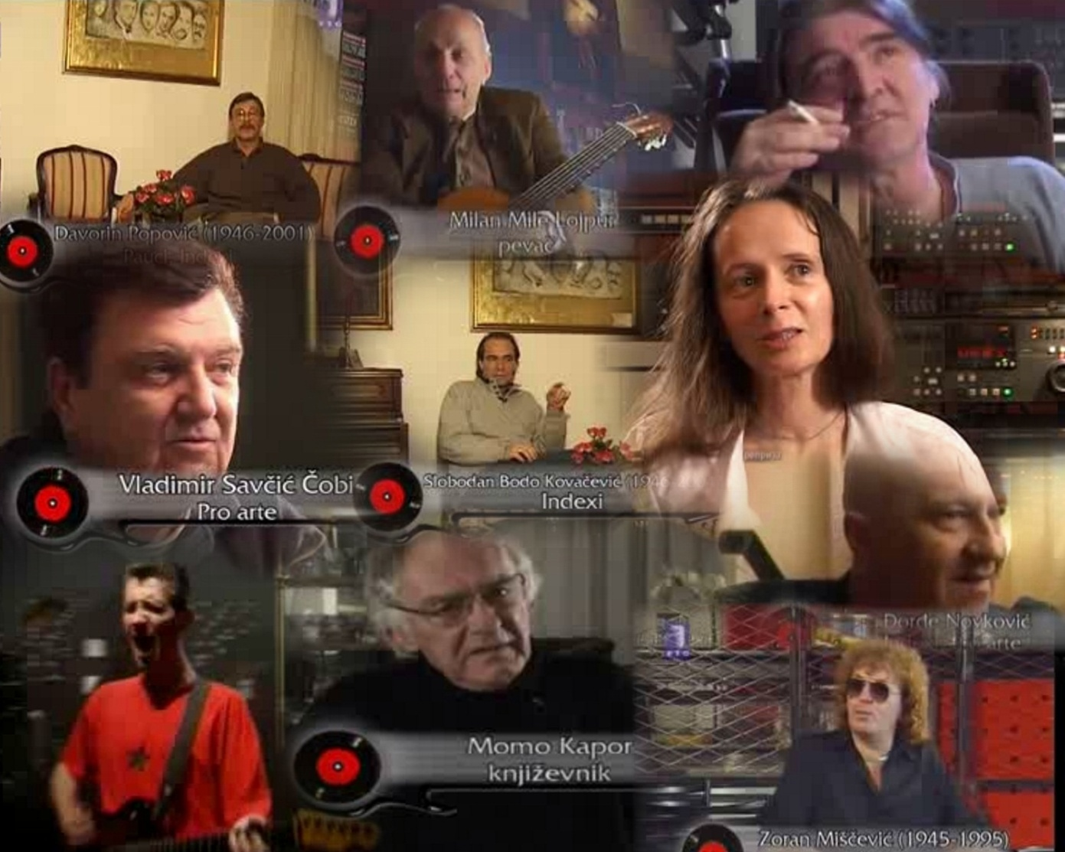
Contributors: dead
We must conclude that we catch last train to start our project.
Notes:
That is life.
Since 1999, some participants died,
so this archive contains not only their songs, but also last interviews and precious footage and testimony of some of the top former Yugoslav artists.

Slide 20
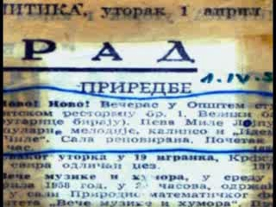
Challenges and difficulties: scarce material
1. Album covers, tickets, posters were highly deteriorated by threading
2. Color change with lost of darkness made some text material almost unreadable
Notes:
Solution: multi step digitization
Step 1: shooting with low quality digital photo camera
Step 2: shooting with high quality digital photo camera
Step 3: Many different OCR software packages were tested. Generally,
the result of OCR was inaccurate and plain texts had to be manually corrected.
Step 4: Also, articles were manually corrected to provide enough data for other analyses,
like searching based on articles content.

Slide 21
Behind Rockovnik audience
We are proud that our material is used by teachers in primary and secondary school (supporting history, music and literacy lessons)
Positive example: History textbook in primary school (8th grade), authors:S. Rajić, K. Nikolić, N. Jovanović
Publisher: Institute for Textbooks and
Teaching Aids, Belgrade, 2006

Slide 22
Behind Rockovnik feedback
Lot of forums, blogs about Rockovnik
12 h of video material downloaded from Rockovnik and uploaded in YouTube with numerous views and comments
13400 results on Google
high precision and recall
274 Web home pages with different host dedicated to Rockovnik
Notes:
100% precision and recall,
Oficial page www.rockovnik.com is included

Slide 23
Future development
1. to give non-Serbian
speaking audience better access
to the multimedia database
2. to continue collecting material
3. more quantitative analysis of data:
data and text mining,
multimedia information retrieval

Slide 24
Q&A
Thank You!!!

