Slide 1

Library material digitisation project coordination and E-content national aggregator in the field of culture
mag. Zoran Krstulović
Mojca Šavnik
National and University Library, Slovenia
6th SEEDI Conference
Zagreb, 18. – 20. May 2011

Slide 2

Let me take you to…
Notes:
The Queen not so far ago wanted to ride a bicycle… I am not a queen, but I´d like to take you on a ride…

Slide 3
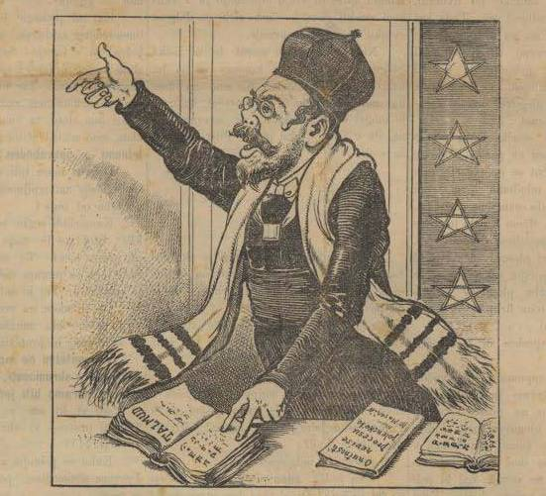
But, we have some serious business to do in a very short time…
Notes:
But, we are here to be serious, so let us do serious bussienes…

Slide 4
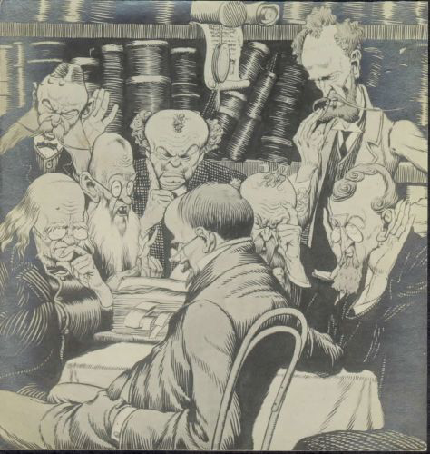
2006
National and University Library (NUK) established the Digital Library Development and Strategy Division
2010
under the Division has formed a new significant task
coordination of digitisation on the state level

Slide 5
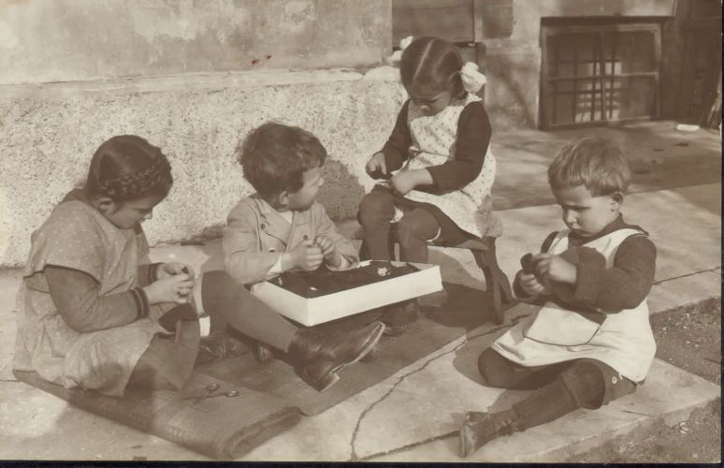
coordination
preparation of
technical documentation
monitoring of digitization process,
collaboration with selected
outsourced contractors for digitization
acquisition of digitized material
publishing on the portal of the Digital Library of Slovenia

Slide 6
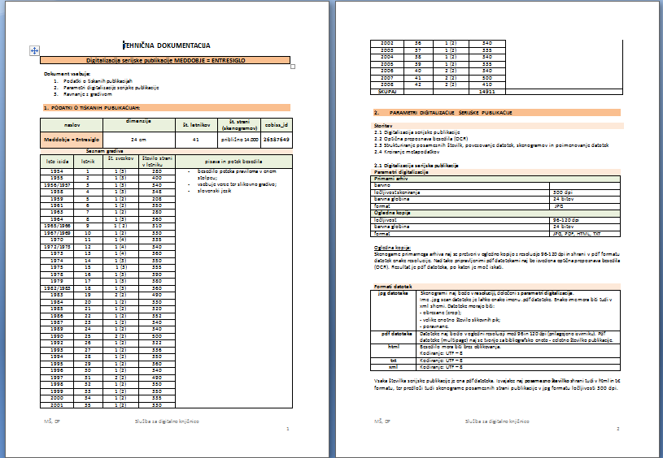
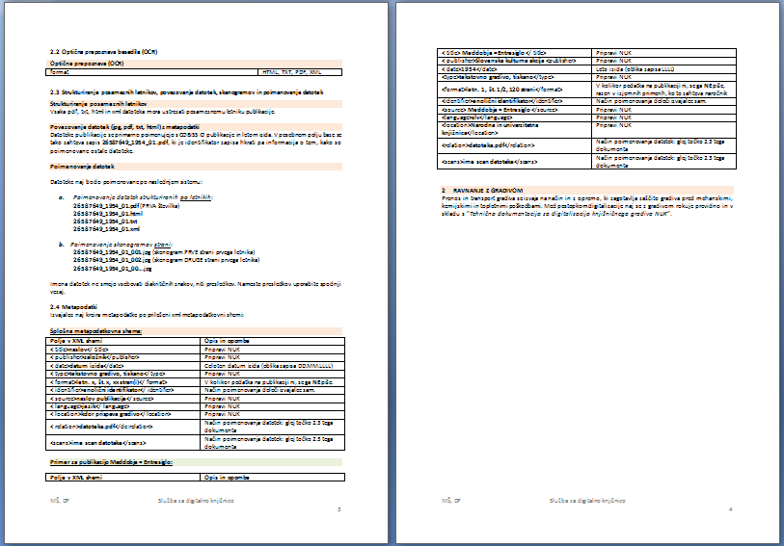
Technical documentation

Slide 7
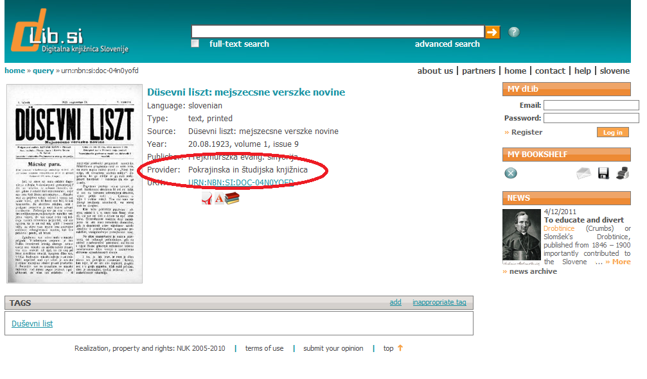
2010
more than 30 projects of digitization materials from a different Slovenian libraries

Slide 8
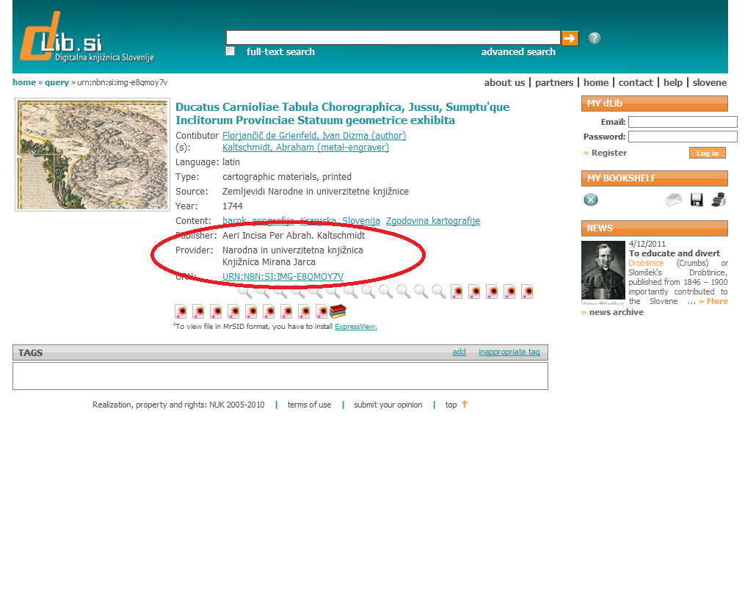
Material duplication
Coordination at the national level had started
attempt to prevent duplication of digitization of library
contribution to the rational use of public funds
virtual unification of library material that is spread over Slovenian libraries and beyond

Slide 9
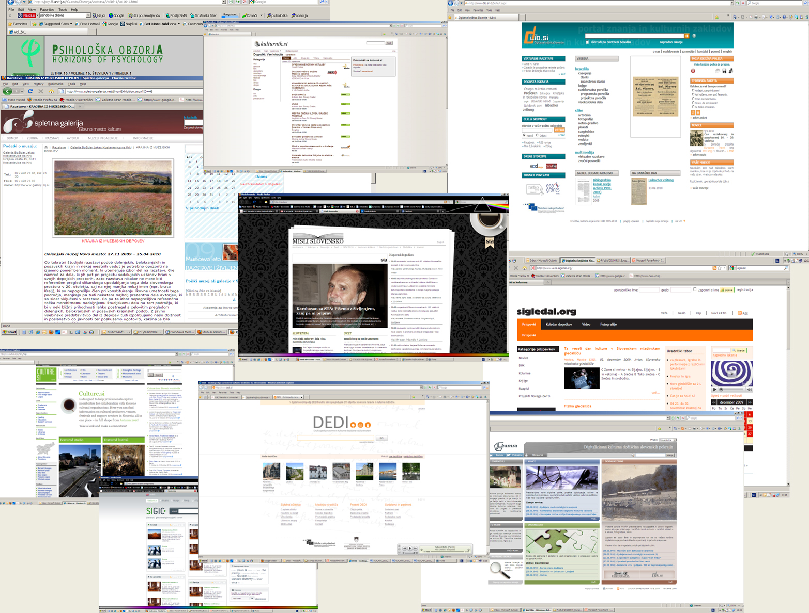
Slovenian e-content portals landscape
8/13

Slide 10
State of art analysis of e-content preservation and distribution
  - in the cultural sector in Slovenia, currently there is not an umbrella organization or institution or body that would provide appropriate guidance and would help to cultural public institutions to shape their own cultural content digitization strategies,
  - there is lack of education, counselling and awareness about content digitization and importance to implement digitization processes in organisation,
  - in the Slovenian web space there are some major portals with content from the cultural sector who have the potential to become the central field portals
  - there are the lack of coordination, cooperation and communication of results between the various, sometimes even competitive, digitization projects,
  - copyright regime create an additional obstacle to faster e-content creation.
7/13

Slide 11
Implementation of national e-content aggregator in the field of culture
  - Decision of the Ministry of Cuture (14.9.2009)
  - reflected newly created European integration (European digital library)
  - created a more in-depth cooperation among the key players in the field of culture and science
  - to desire to coordinate creating e-content (digitized and born digital) produced with public funds
  - Task have assigned to National and University LIbrary
5/13

Slide 12
Main goals
  - to provide a uniform and permanent access to e-content in the field of culture and science,
  - to provide open and easy access to the Slovenian e-content in culture through the WWW,
  - to stimulate the creation of e-content in public institution in the field of culture
  - to establish cooperation and synergy between the existing and future portals that provide access to e-content in the field of culture and science,
  - to facilitate the transfer of Slovenian cultural content in digital form,
  - to provide a platform for implementation conditions for permanent storage of Slovenian e-content in the field of culture,
  - to develop modalities for legal public accessibility of digitized works,
  - to ensure the functioning of national aggregator as link to the Europeana.
6/13

Slide 13
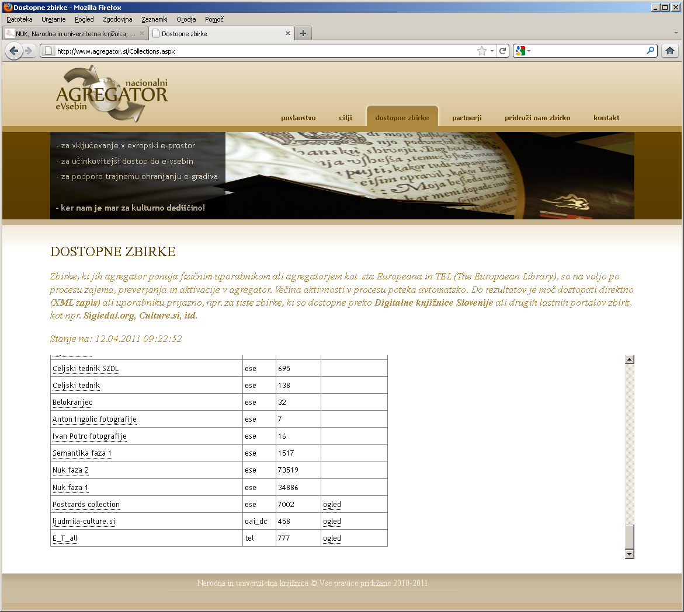
www.agregator.si
12/13

Slide 14


Digitalna knjižnica Slovenije www.dLib.si
zoran.krstulovic@nuk.uni-lj.si
mojca.savnik@nuk.uni-lj.si

