Slide 1
A project for the digitalisation of a manuscript bibliographic unit
- opportunities for and implementation of the virtual contextualisation of text
M.sc. Snježana Radovanlija Mileusnić
Museum Documentation Centre, Zagreb
sradov@mdc.hr

Slide 2
INTRODUCTION
In brief concerning the project Digitalisation of the old and rare book holdings of the Bauer Collection of the MDC Library
In brief about the Bibliography and material for art and similar disciplines

Slide 3
The project Digitalisation of the old and rare book holdings of the Bauer Collection of the MDC Library
preserving the intellectual contents of the old and rare book material that is kept in the library of the Museum Documentation Centre (MDC)
covers publications unique in terms of their museological theme and one-off in terms of the number of preserved specimens in other Croatian heritage establishments as well as publications that because of their age are worn-out and liable easily to be damaged
In the first phase of the project, some of the manuscript material of the oldest library collection was digitalised: the Bauer Collection
Notes:
The project Digitalisation of the old and rare book holdings of the Bauer Collection of the MDC Library is devised with the objective of preserving the intellectual contents of the old and rare book material that is kept in the library of the Museum Documentation Centre.
The project covers publications unique in terms of their museological theme and one-off in terms of the number of preserved specimens/copy in other Croatian heritage establishments/institutions as well as publications that because of their age are worn-out and liable easily to be damaged.
In the first phase of the project, some of the manuscript material of the oldest library collection was digitalised: the Bauer Collection

Slide 4
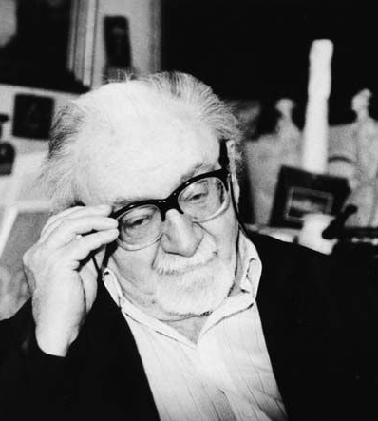
Antun bauer (1911. – 2000.)
Dr. ANTUN BAUER
prominent archaeologist, museologist and collector, as well as the initiator and founder of and donor to numerous museum institutions in Croatia
Notes:
The Collection comprehends the donation of the MDC founder, Dr Antun Bauer, prominent archaeologist, museologist and collector, as well as the initiator and founder of and donor to numerous museum institutions in Croatia

Slide 5
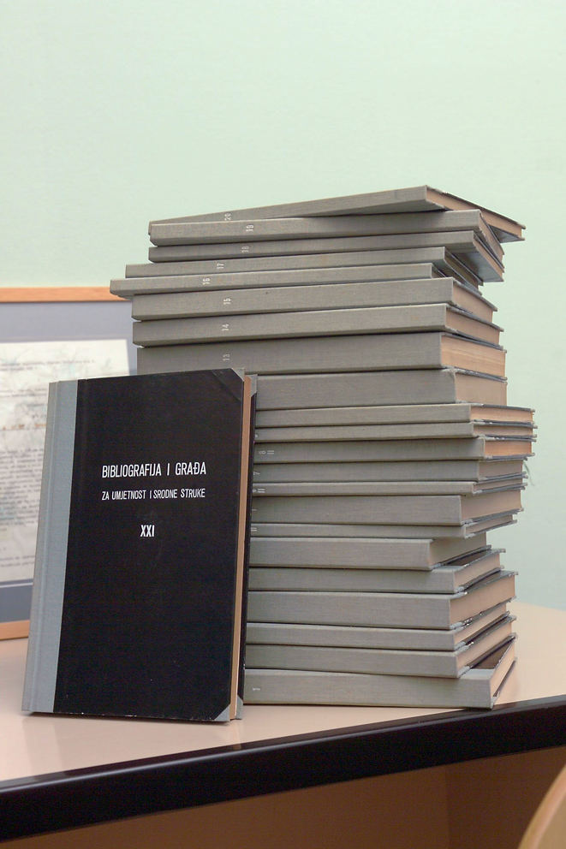
Bibliografija i građa za umjetnost i srodne struke (Bibliography and material for art and similar disciplines)
Zagreb, 1951-1958
31 numbered books
bibliographic, biographical and documentary material from cultural history, particularly the fine arts and historical museology from the 19th century to the 1950s, from Croatia and the whole of the former Yugoslavia
edited by Antun Bauer
Notes:
In the first phase of the project, part of the unique MS bibliographic unit Bibliography and material for art and similar disciplines (Zagreb, 1951-1958) has been digitalised. The unit is made up of 31 numbered books that combined bibliographic, biographical and documentary material from cultural history, particularly the fine arts and historical museology from the 19th century to the 1950s, from Croatia and the whole of the former Yugoslavia.
The material in the Bibliography is a unique document of exhibition events and a starting point (of departure) for varied cultural, art history and museological researches.

Slide 6
bibliographic unit can be divided into four basic thematic units:
Gipsotheque collections
- no. VIII, IX
Chronologies of exhibitions (from 1840 to 1952)
- no. XXIII, XXIV, XXV, XXVI, XXVII, XXVIII
Biographies and autobiographies of visual artists
- no. VII, XXI, XXII, XXIX, XXX
Bibliographies of articles (about 30,000 selected bibliographical entries, listed from 72 periodical titles)
- no. I, II, III, IV (1,2), V (1,2), VI (1,2), X, XI, XII, XIII, XIV, XV, XVI, XVII, XVIII, XIX, XX, XXXI
Notes:
With respect to the themes represented and the structure of the contents, books from this bibliographic unit can be divided into four basic thematic units:
Gipsotheque collections,
2. Chronologies of exhibitions (the books contain chronologies of individual and collective exhibitions held in Croatia, in the towns of the former Yugoslavia and a chronology of important exhibitions of Croatian artists held abroad from 1840 to 1952),
3. Biographies and autobiographies of visual artists (the books also contain a list of and biographies of fine artists from the card index system of the fine artists of Yugoslavia of the Fine Arts Archives, and autobiographies of fine artists collected in the Archives of the Federation of Fine Artists of Yugoslavia),
4. Bibliographies of articles (retrospective bibliographies of articles from specialised periodicals, papers, dailies and reviews issued in Croatian and the former Yugoslavia and abroad since their first appearance up to the 1950s); about 30,000 selected bibliographical entries related to artistic and cultural life, listed from 72 periodical titles

Slide 7
The objection and purpose of the digitalisation and Web presentation of Dr Bauer’s Bibliography and material for art and similar disciplines
Why digitalisation
The objective and purpose of Web presentation

Slide 8
Why digitalisation
the exceptional value of the content of the bibliographical unit that is a resource for research in art history, museology and culture studies,
a high degree of information value deriving from the structure and organisation of the contents (featuring the forms of bibliography, lexicon and timeline),
the one-of-a-kind cultural history and bibliographic importance in the contemporary context
high collateral value
Notes:
The careful selection of the Bibliography (and material for art and similar disciplines) for digitalisation took into account several basic criteria.
With respect to the content, context and meaning of the original of the Bibliography we identified:
- the exceptional value of the content of the bibliographical unit that is a resource for research in art history, museology and culture studies,
- a high degree of information value deriving from the structure and organisation of the contents (featuring the forms of bibliography, lexicon and timeline),
the one-of-a-kind cultural history and bibliographic importance in the contemporary context.
As well as all this, the Bibliography has a high collateral value for its editor is Dr Antun Bauer, also the founder of the MDC and the donor of many books, including the Bibliography.
Similarly, over the course of time, the Bibliography has taken on emblematic significance, which contributes to the recognition of the uniqueness of the MDC library holdings

Slide 9
The objective and purpose of Web presentation
disseminate information about the existence of the Bibliography and its bibliographic and information contents to a wider circle of potential users,
upgrade specialised and scholarly research work,
provide support to tertiary level curricula,
increase the attractiveness of the material to a broader circle of users with varied user needs,
acquaint the public with the manuscript and unpublished book material important for the history of museology,
enable distance-consultation of the Bibliography without restrictions as to time and place,
reduce time spent to find sought bibliographic information
enable the making of digital copies
improve the quality of the information sought (for only some of the 33 volumes are accompanied by an index), and
popularise the holdings of MDC library
Notes:
But enabling free examination of the original MS via digital copies on the Web was not our ultimate objective.
The point of Web presentation was seen in the addition of value that with text and image and references would contextualise the contents of the entire bibliographic unit, and of each individual volume, explain them in detail and, enriched in this way, offer them to the users of virtual contents.
+
On the slide are listed the objective and purpose of web presentation!

Slide 10
The structure, contents and data of the Web presentation of digitalised contents

Slide 11
CONTENTS
The Web presentation was produced as a component part of the site of the MDC accessible at:
http://antunbauer.mdc.hr/index.php/static
the Bauer Collection,
the Digitalisation Project,
Antun Bauer,
the bibliographic unit,
the thematic groups of the Bibliography
and each one of the 33 volumes and their contents and authors, along with ancillary illustrative material
Notes:
The Web presentation was produced as a component part of the site of the MDC.
KLIKNUTI NA LINK I PROČITATI:
This gave rise to additional information about:
the Bauer Collection, the Digitalisation Project, Antun Bauer,
KLIK NA BIBLIOGRAFIJA I GRAĐA - the bibliographic unit,
KLIK NA KRONOLOGIJE IZLOŽABA - the thematic groups of the Bibliography
and
KLIK NA KNJIGU XXVIII
each one of the 33 volumes and their contents and authors, along with (ancillary) illustrative material.
Through books grouped in terms of themes and search engines of their contents we have facilitated the search of individual books in the bibliographic unit.
POVRATAK NA SLAJD!

Slide 12
structure
Level one: digitalised contents
of the 14 completely digitalised books with 2754 digitalised copies
http://antunbauer.mdc.hr/index.php/static/flash/V_1
http://antunbauer.mdc.hr/index.php/static/flash/XXIII
http://antunbauer.mdc.hr/index.php/static/flash/XXIX
Notes:
These contents on the Web pages of the Bibliography and material for art and similar disciplines of Dr Antun Bauer are arranged into three linked but yet independent levels.
At level one it is possible to show the digitalised contents of the 14 completely digitalised books with 2754 digitalised copies.
KLIK NA LINK I PROČITATI:
They can be reviewed by scrolling, enlargement of the text or seeking a certain page number.
This enables an unhindered inspection of the original specimen to every interested user of the world’s virtual community.

Slide 13
Level two: a static text with hypertextual characteristics
introductory texts;
interpretative texts alongside each thematic unit and along with every individual book of the Bibliography;
metadata / cataloguing data about each book;
more extensive textual representations of the individual books
Notes:
At level two is a static text with hypertextual characteristics.
These are textual descriptions of individual components of the project
introductory texts;
interpretative texts alongside each thematic unit and along with every individual book of the Bibliography;
metadata / cataloguing data about each book;
more extensive textual representations of the individual books

Slide 14
A. among the contents within the project
from a description of one book to that of another with cognate contents;
http://antunbauer.mdc.hr/index.php/static/bibliografije/II
from a single table with a list of periodicals and papers to books with their thematic bibliographies;
http://antunbauer.mdc.hr/index.php/static/bibliografije
from search results to the digital copy
Notes:
By the use of hyperlinks within all these texts an interconnection between different kinds of digital contents was established.
These connections were established:
1. among the contents within the project
KLIK NA LINK! - from a description of one book to that of another with cognate contents;
KLIK NA LINK- from a single table with a list of periodicals and papers to books with their thematic bibliographies (NPR. GLASNIK ZEMALJSKOG MUZEJA BIH);
- from search results to the digital copy

Slide 15
B. among project contents and other contents on the MDC Web site
links to data in the on-line Register of Museums, Galleries and Collections of the Republic of Croatia
http://www.mdc.hr/hr/muzeji-u-hrvatskoj/hvm-pregled-muzeja/
e.g. http://antunbauer.mdc.hr/index.php/static/zbirke
links to the Personal archives of museum professionals at http://www.mdc.hr/hr/mdc/arhiv/personalni-arhiv-zasluznih-muzealaca/
and to the MDC library catalogue at http://www.mdc.hr/hr/mdc/knjiznica/katalog-knjiznice/
Notes:
b. among project contents and other contents on the MDC Web site
links to data in the on-line Register of Museums, Galleries and Collections of the Republic of Croatia
links to the Personal archives of museum professionals
and to the MDC library catalogue
E.g. KLIKNUTI na stranicu pa na “Gliptoteka”

Slide 16
C. to outside Web contents
for example:
the presentation of the book containing the MS of Ivan Rengjeo about stechaks (no. 8 of the Bibliography)
http://antunbauer.mdc.hr/index.php/static/zbirke/VIII
a link to Rengjeo’s texts in pdf. format published on other Web sites:
http://www.plsavez.hr/hp-arhiva/194208.pdf
Notes:
These connections were established:
C. to outside Web contents
for example, KLIK NA PRVI LINK I ČITATI S POKAZIVANJEM:
the presentation of the book containing the forgotten, unpublished MS of Ivan Rengjeo contained in the 8th volume of the Bibliography, which is also the most recent content within the project that we are showing for the first time.
This MS was a starting point for the exploration and publication of lesser known data from his life, his work with Dr Bauer on a number of projects, his work in the research into stechaks and his participation in the Exhibitions of the Medieval Art of the Peoples of Yugoslavia held in Paris in 1950 and in the Art Pavilion, Zagreb, in 1951.
The presentation of the book has a links to external Web contents that contribute to the virtual contextualisation of this MS – for example, a link to Rengjeo’s texts in pdf. format published on other Web sites KLIKNUTI IZ MOG TEKSTA NA RENGJEOVE STEĆKE U PLANINARU!!
We hope that the digitalised MS will be a start-point for research by the wider professional and scholarly community, for with its presentation of the Web, it will become accessible to all inheritors of stechaks and the common cultural heritage as well as other interested members of the world’s virtual community.

Slide 17
d. connections with other repositories of digitalised material
links to the digitalised repository of the Croatian Academy of Sciences and Arts about certain contents in the project,
e.g., a link has been established from the digitalised catalogue of the exhibition 1st Spring Salon,1916
http://hazu.arhivpro.hr/index.php?search=2&paging=1&query=proljetni+salon
to the digital copy from the Bibliography with information about this exhibition
http://antunbauer.mdc.hr/index.php/static/flash/XXIII-083
Notes:
And, connections were established:
d. with other repositories of digitalised material
For now that are links to the digitalised repository of the Croatian Academy of Sciences and Arts about certain contents in the project,
KLIKNUTI NA LINK
e.g., a link has been established from the digitalised catalogue of the exhibition 1st Spring Salon, 1916
KLIKNUTI NA DRUGI LINK
to the digital copy from the Bibliography with information about this exhibition.

Slide 18
The third level: a search engine for the data base
http://antunbauer.mdc.hr/index.php/search
- contains 1276 bibliographical entries
- from two books (nos. XXIII and XXIV)
- that relate to the chronology of exhibitions held in Zagreb from 1842 to 1952
searchable according to the following criteria:
artist, exhibition venue, year and name of exhibition
Notes:
The third level of Web presentation of the Bibliography is a search engine for the data base KLIK NA LINK!,
which contains 1276 bibliographical entries from two books that relate to the chronology of exhibitions held in Zagreb from 1842 to 1952.
Because of the physical characteristics of the originals it was impossible to carry out the digitalisation of the material by OCR. Hence the whole contents of two books were first transcribed. In order to preserve the authenticity of the document, the content was transcribed literally without any interventions into language or grammar.
The base is searchable according to the following criteria: artist, exhibition venue, year and name of exhibition.
KLIK NA “1. GODIŠNJA IZLOŽBA HRVATSKIH UMJETNIKA”
The results of each search are connected via the titles of the exhibitions to the digital copy from the Bibliography and supported with the currently available and digitalised copies of the covers of catalogues of the exhibitions from the holdings of the library of MDC.

Slide 19

Concluding considerations
Through this added value we endeavoured virtually to contextualise the digitalised contents, in which we perceived the basic objective and purpose of the Web presentation of this old MS material
The project has been conceived as an open form that can be constantly upgraded and updated with new knowledge, textual and imaged material, new digital copies and new hyperlinks.
We see the future of the project Digitalisation of old and rare material from the Bauer Collection of the MDC library in the further linkage of contents of repository digital material on various portals
Notes:
In the making of the web pages, we enriched the Bibliography and its fourteen digitalised books with added contents – additional texts (descriptions, lists, transcriptions, catalogue data), image material (digitalised copies of texts, covers, photographs), menus and search engines, which all resulted in a new electronic publication.
Through this added value we endeavoured/tried virtually to contextualise the digitalised contents, in which we perceived/consider the basic objective and purpose of the Web presentation of this old MS material.
The project has been conceived/designed as an open form that can be constantly upgraded and updated with new knowledge, textual and imaged material, new digital copies and new hyperlinks.
We see the future of the project Digitalisation of old and rare material from the Bauer Collection of the MDC library in the further linkage of contents of repository digital material on various portals, as illustrated by the links made between the Croatian Academy and the MDC portal.

