Slide 1
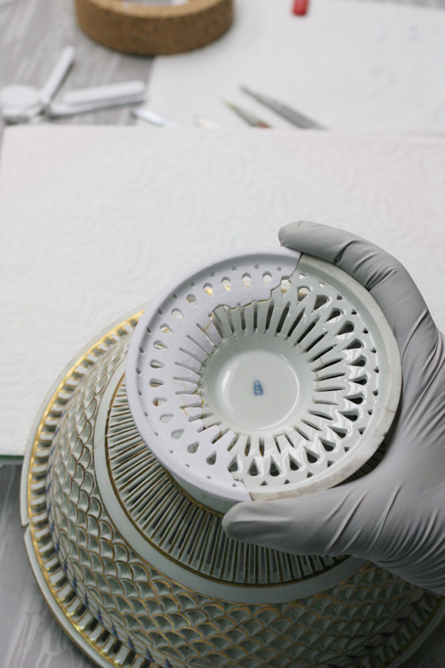
Restoration of a fruit bowl with a leg
using 3D technologies
Kaja Antlej, Young Researcher
IB-PROCADD d.o.o.
kaja@ib-procadd.si
Coauthors:
Kristjan Celec, Menaf Sinani, Erazem Mirtič, Darja Ljubič
IB-PROCADD d.o.o.
Janja Slabe, Gorazd Lemajič, Mateja Kos
National Museum of Slovenia
The Sixth SEEDI Conference
Digitization of Cultural and Scientific Heritage
Zagreb, Croatia, 18-20 May 2011

Slide 2
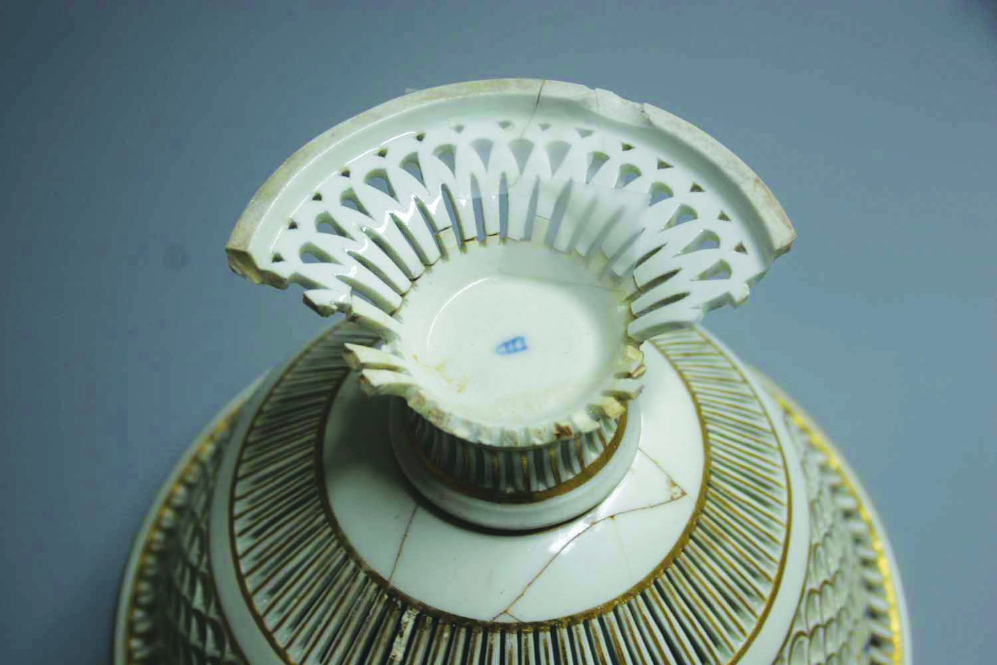
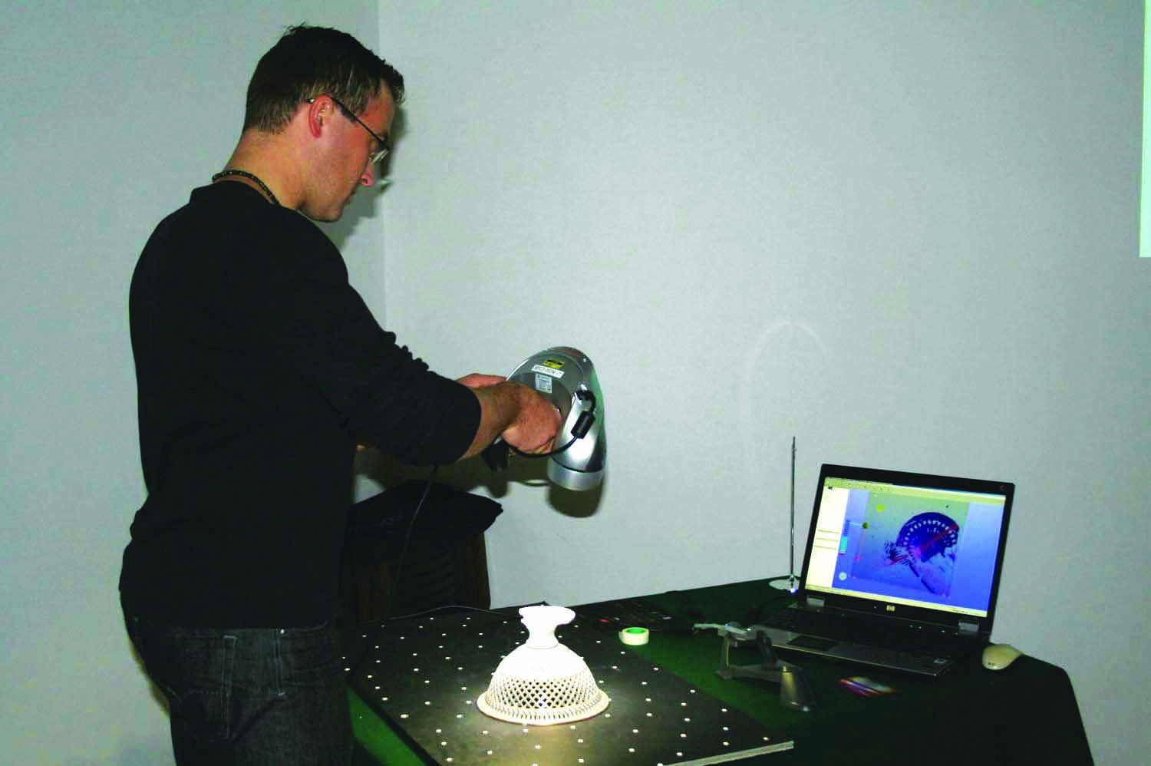
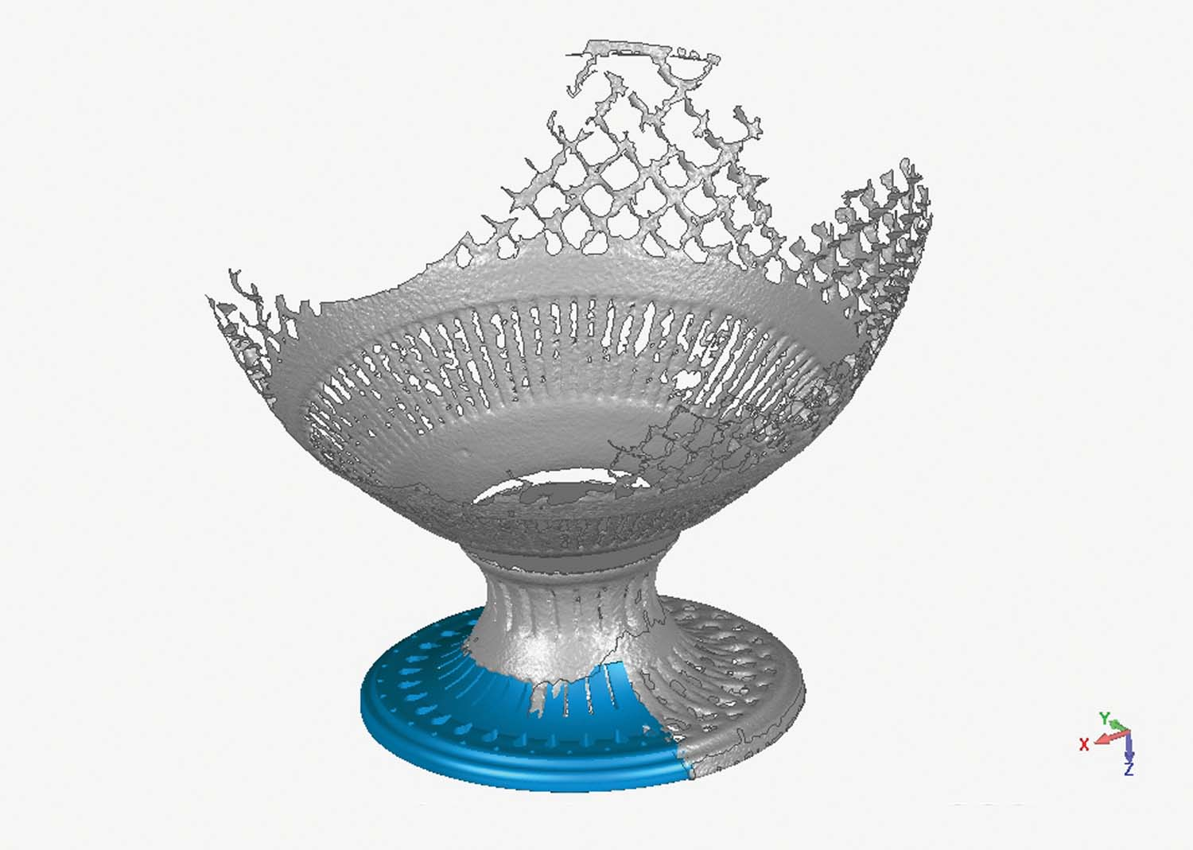
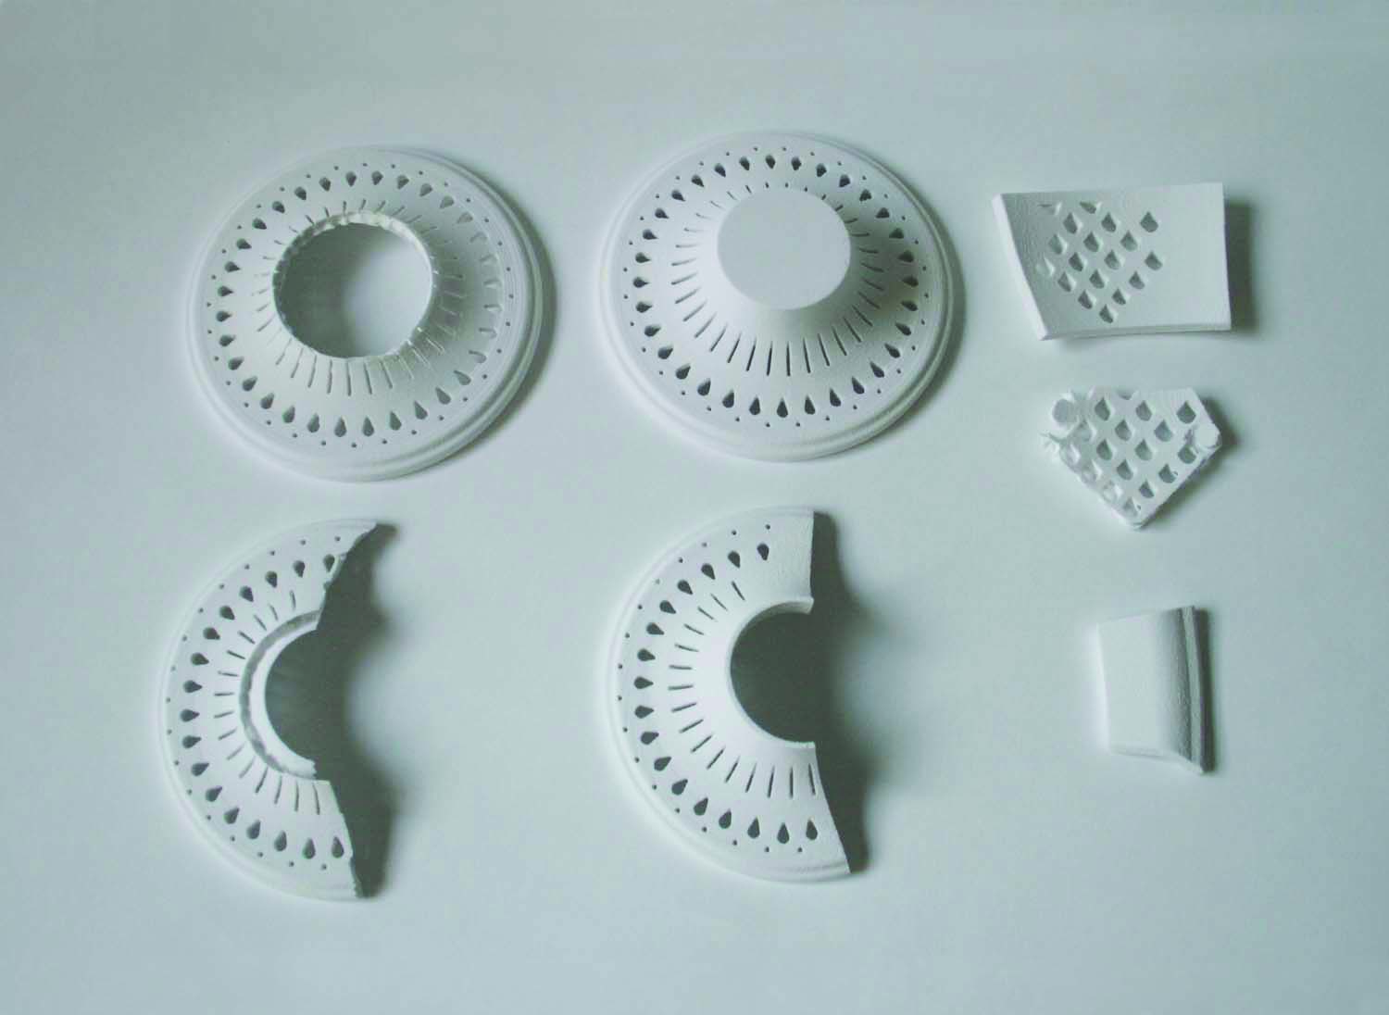
Introduction: Content and Structure
Restoration of a stemmed fruit bowl* using 3D technologies
A stemmed fruit bowl as a museum object
The preparing and making of the reconstructed missing fragments
- 3D digitization
- 3D computer reconstruction
- 3D printing of the fragments for replacing the missing areas
Restoration of a stemmed fruit bowl
- The completion of the bowl with the 3D printed fragments.
Conclusions and further work
*Corrected translation

Slide 3
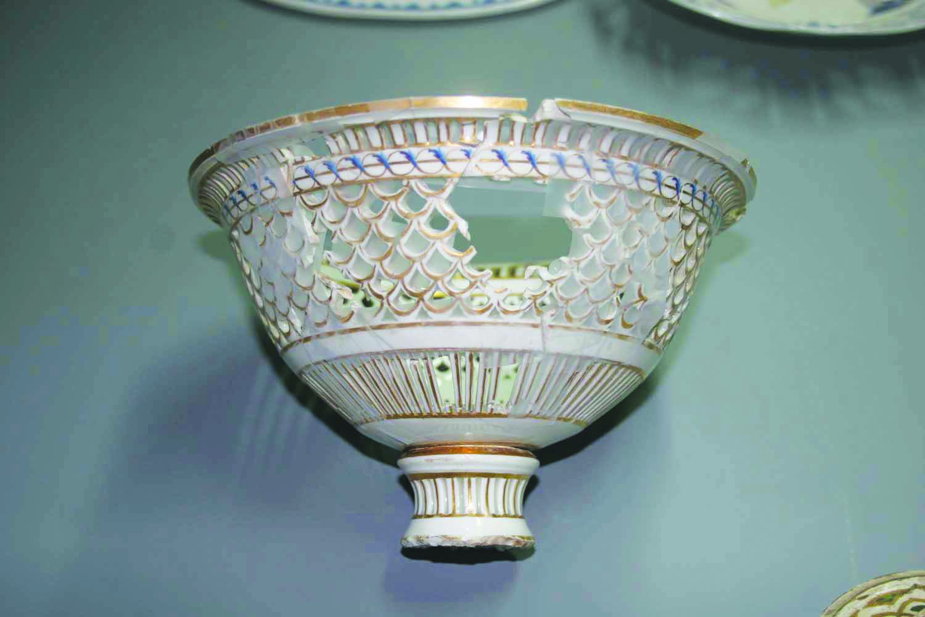
A stemmed fruit bowl as a museum object
The table service from porcelain collection of the National Museum of Slovenia
- Vienna Porcelain Manufactory (Wiener Porzellanmanufaktur)
- classicist style
early 19th Century
in accordance with the trend, the service is beside central set for lunch, completed with the ware for coffee, tea and dessert
pattern of geometric sequences of perforations, gilding and sprinkled flowers was one of the most appreciated at that period

Slide 4
A stemmed fruit bowl as a museum object
Among the ware for dessert there is a group of three perforated stemmed bowls for fruit and sweets.
Two of them are severally damaged (pictures right).
A part of perforation is missing
A whole foot is missing
1/3 of a foot is preserved

Slide 5
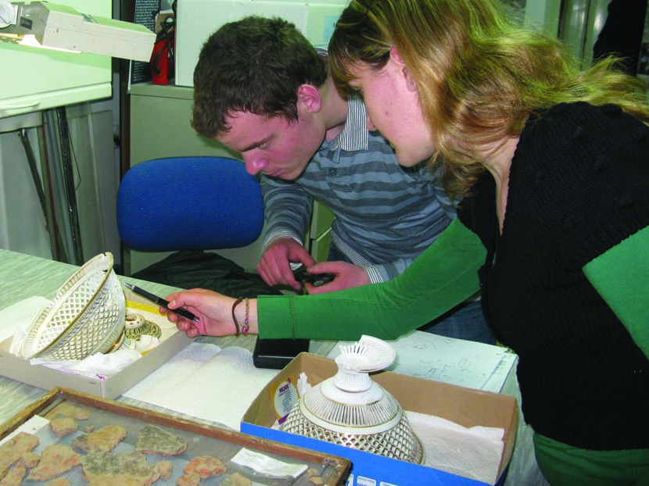
The Preparing and making of the reconstructed missing fragments
1. aim:
Because of the museological doctrine
that we want to present to museum
visitors an impression of the past and
whole diversity of forms of the table ware,
we decided to reconstruct both bowls.
2. aim:
Bowl in is highly perforated throughout its surface, therefore making new fragments with conventional procedure would be a long standing and complicated restoration process. Consequently we try to improve restoration process using
3D technologies.

Slide 6
The Preparing and making of the reconstructed missing fragments
3D digitization
the condition and the damaged parts of the bowls were precisely documented
a handheld 3D laser scanner ZScanner CX:
> uses a red light for scanning

Slide 7
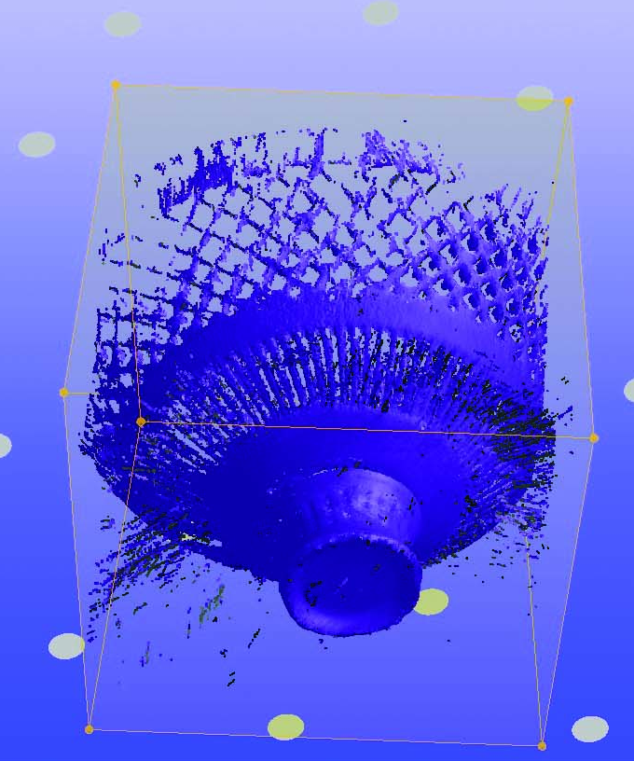
The Preparing and making of the reconstructed missing fragments
3D scanning process
dots for easier positioning of the
3D scanner in space
3D scanner calculates the time that the laser ray travels to the object and back on to the sensor
during digitization capturing of the objects surface can be seen on the screen in STL:
> this means that the point cloud is joining into polygons in real time
> we can watch building of the digitized surface of the object
Notes:
The other possibilities: We can cover the object with dots or with a net which those dots are on.

Slide 8
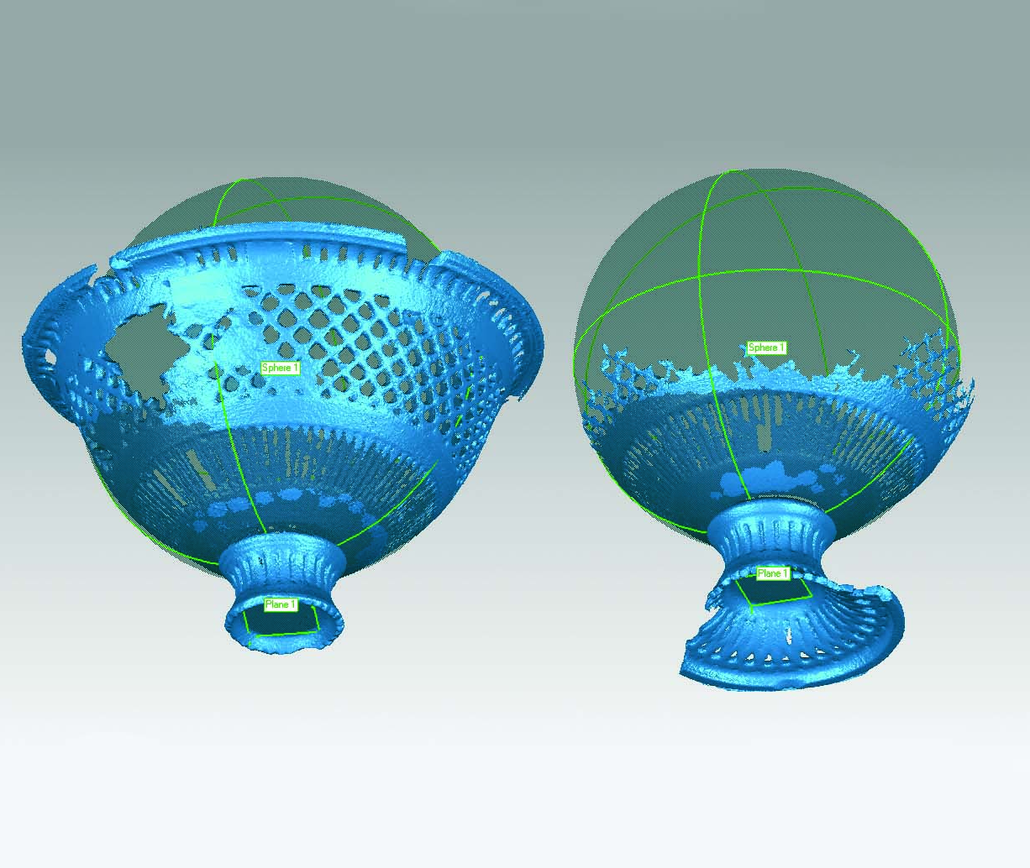
The Preparing and making of the reconstructed missing fragments
The 3D scanograms were later edited
noise was removed
- the surface of the object was closed

Slide 9
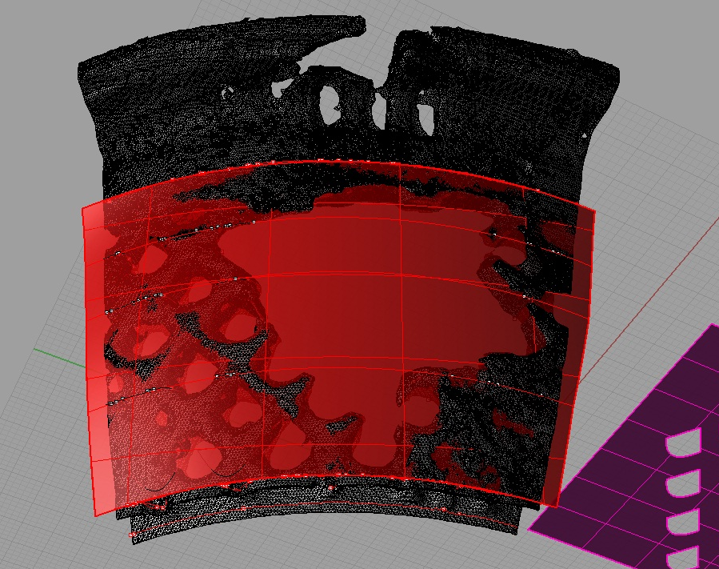
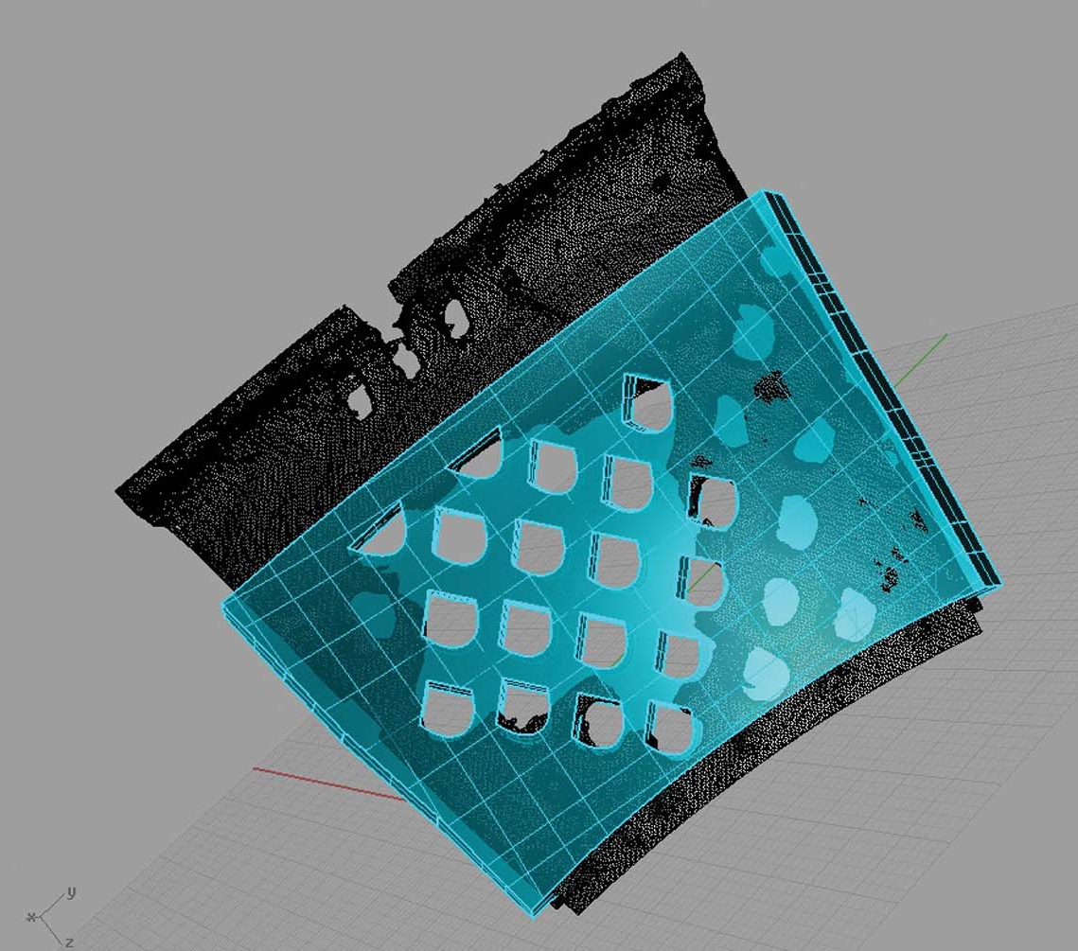
The Preparing and making of the reconstructed missing fragments
Reconstruction of perforations

Slide 10
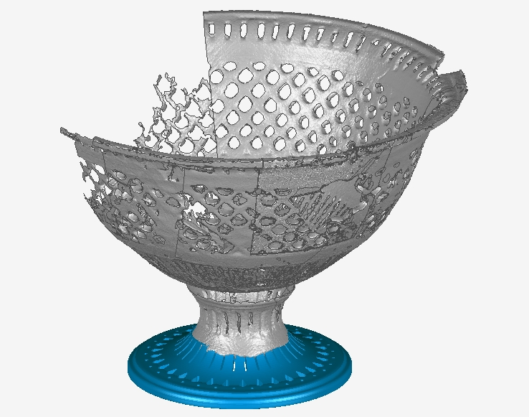
The Preparing and making of the reconstructed missing fragments
Computer reconstructions of two feet (blue) together with
3D scanograms (grey)

Slide 11
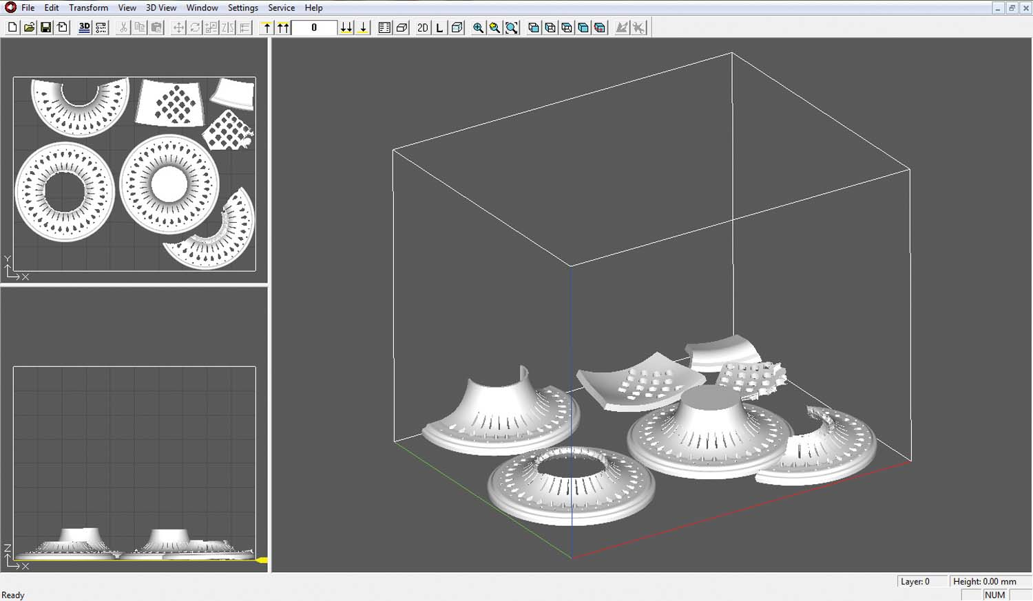
The Preparing and making of the reconstructed missing fragments
3D printing of the fragments for replacing the missing areas
Virtual > Physical
It is important, that every model is watertight, so that the 3D printer perceives it as a solid model.
With other words: a 3D models surface can’t contain holes and other anomalies.
Notes:
Virtual reconstruction was transformed into a physical form with 3D printing.

Slide 12
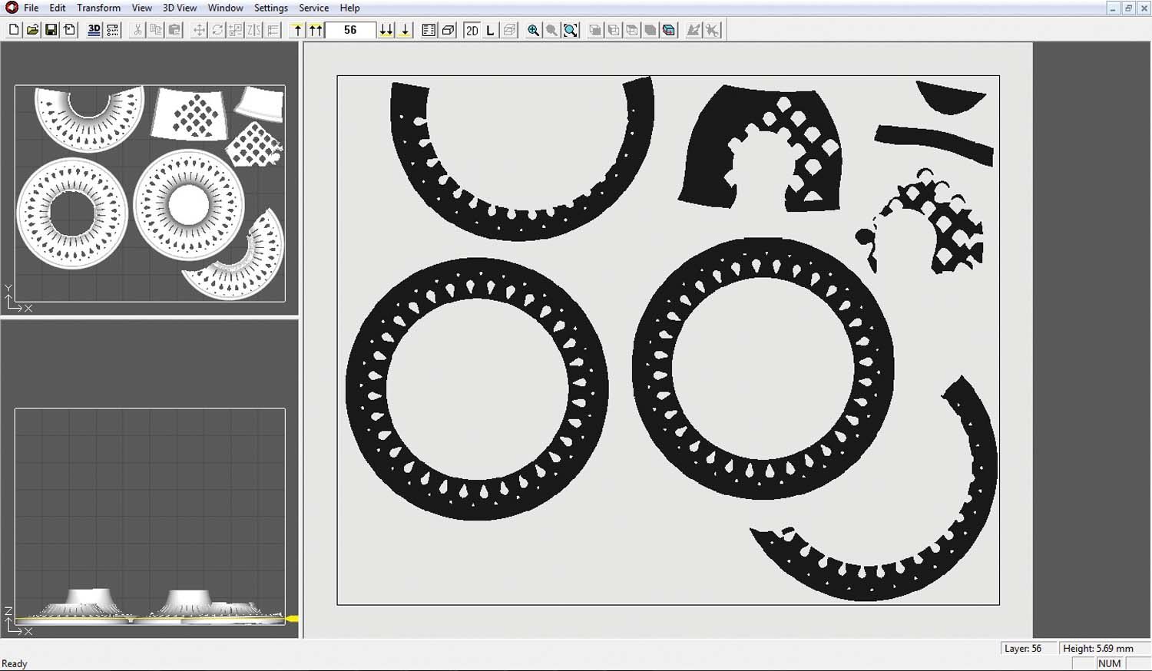
The Preparing and making of the reconstructed missing fragments
The 3D printer transforms data of a 3D model into a 2D picture of each layer of the model.

Slide 13
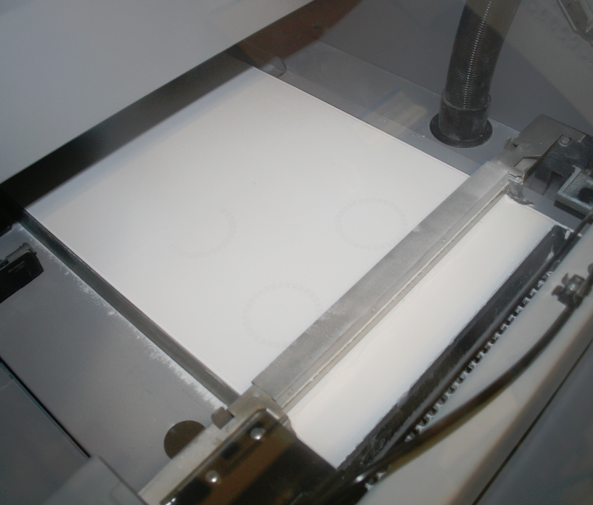
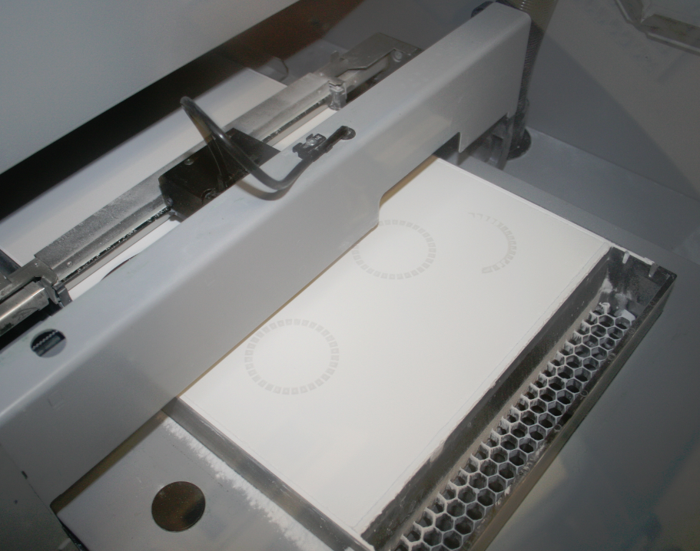
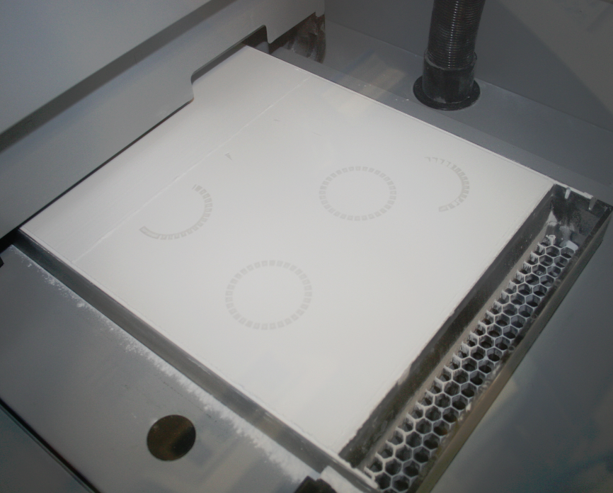
The Preparing and making of the reconstructed missing fragments
3D printing
exchanging of a process of adding (printing) a layer of resin on a thin layer of powder (plaster) (thickness: 0.089 mm)
during the printing process we see just one layer of the part, because all lower layers are hidden in powder
- process is continues until the whole part by its height is built

Slide 14
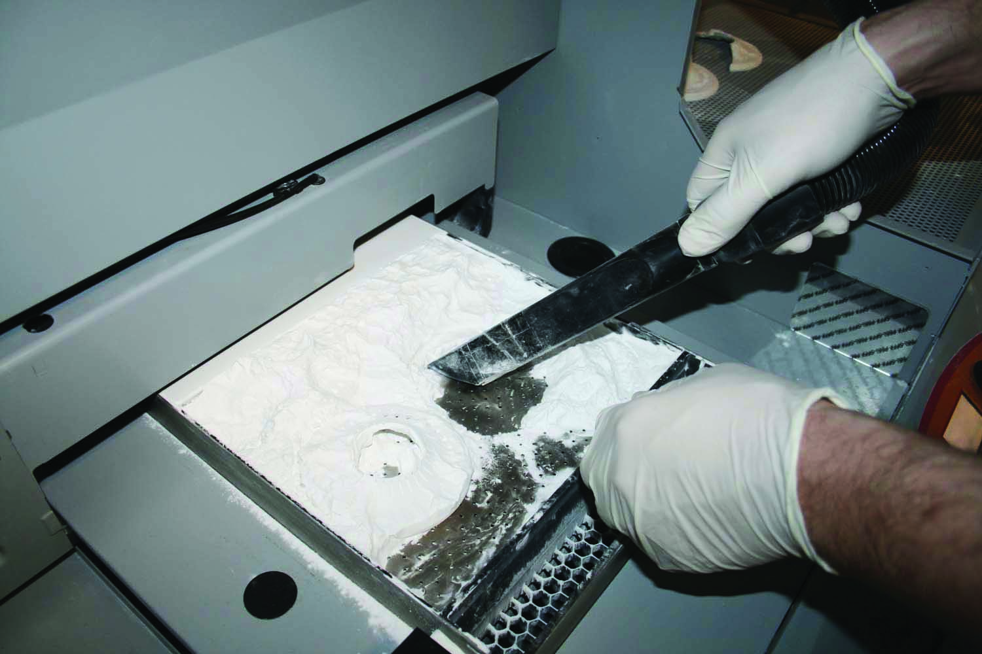
The Preparing and making of the reconstructed missing fragments
When the part is built, unglued powder can be removed with a vacuum cleaner.
Unglued powder can be recycled and used at the next 3D printing.

Slide 15
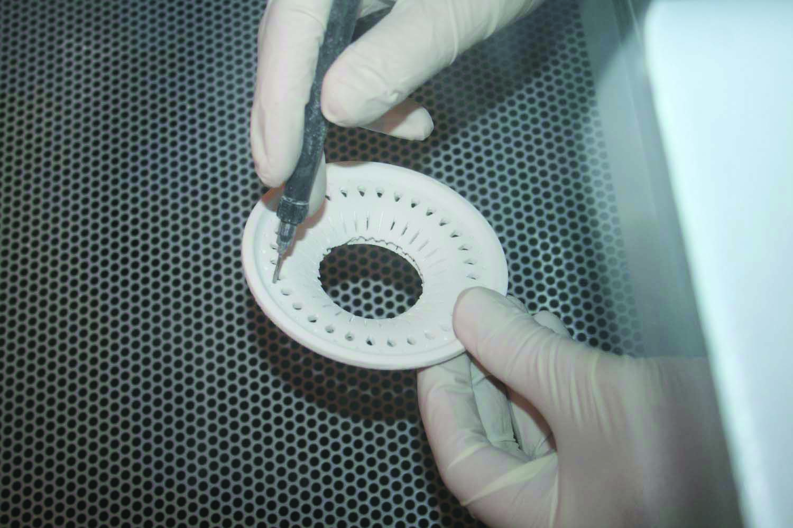
The Preparing and making of the reconstructed missing fragments
Small final parts of the powder can be removed by blowing.

Slide 16
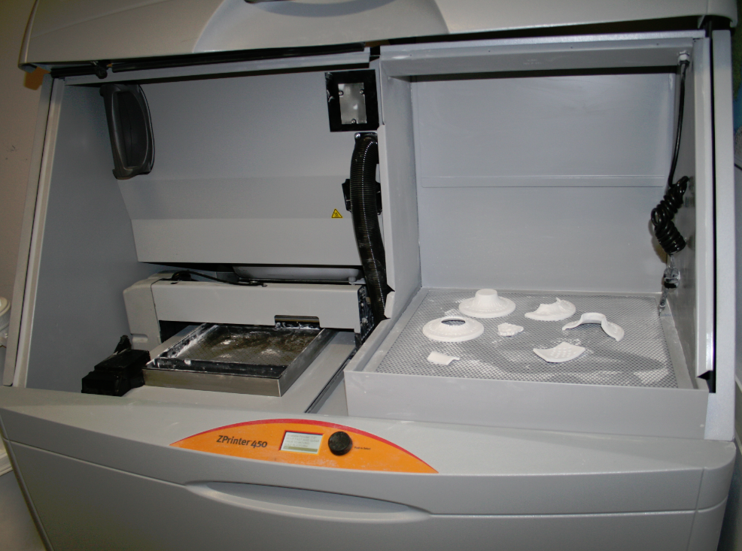
The Preparing and making of the reconstructed missing fragments
Parts, taken directly from a 3D printer are still fragile,
> they need to be impregnated
In our case, the fragments were impregnated after reshaping process
> it was important that the 3D printed parts were soft for handling
All the parts were 3D printed at once with a ZPrinter 450
> build volume:
203 x 254 x 203 mm

Slide 17
The Preparing and making of the reconstructed missing fragments
3D printed parts:
a foot
a third of a foot
a part of a body
a part of an orifice
Two varieties:
one was made to match the share of the missing fragments
one was made larger of the missing fragments with straight conclusions
The reconstructed replicas of the missing parts were included into the process of object completion.

Slide 18
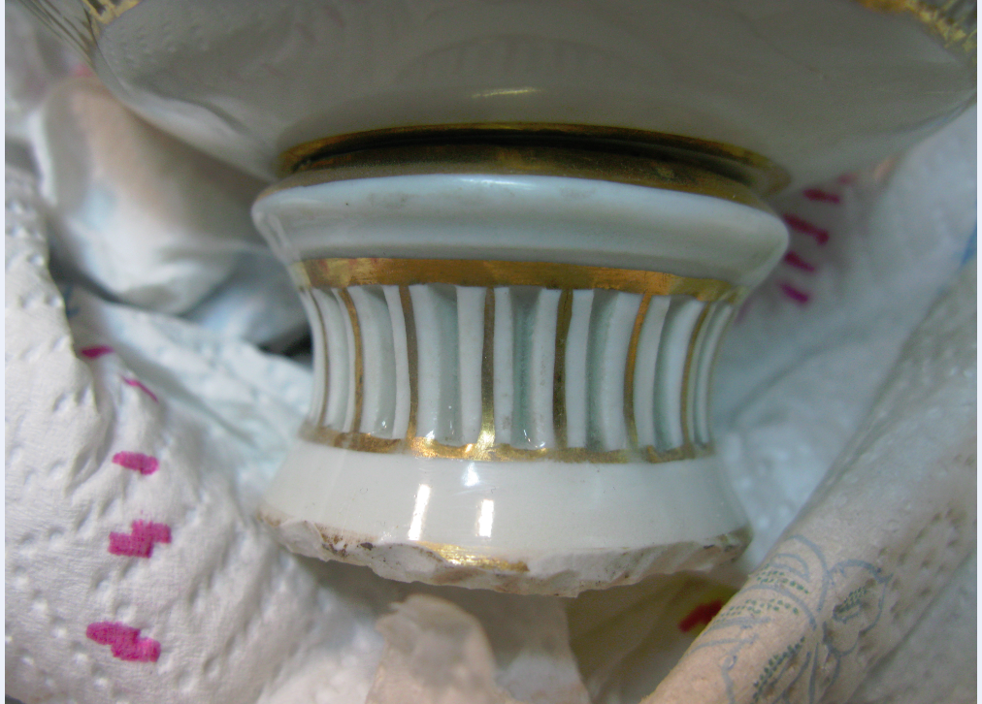
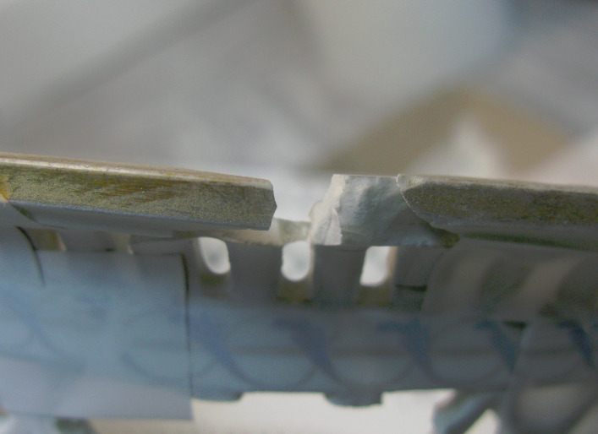
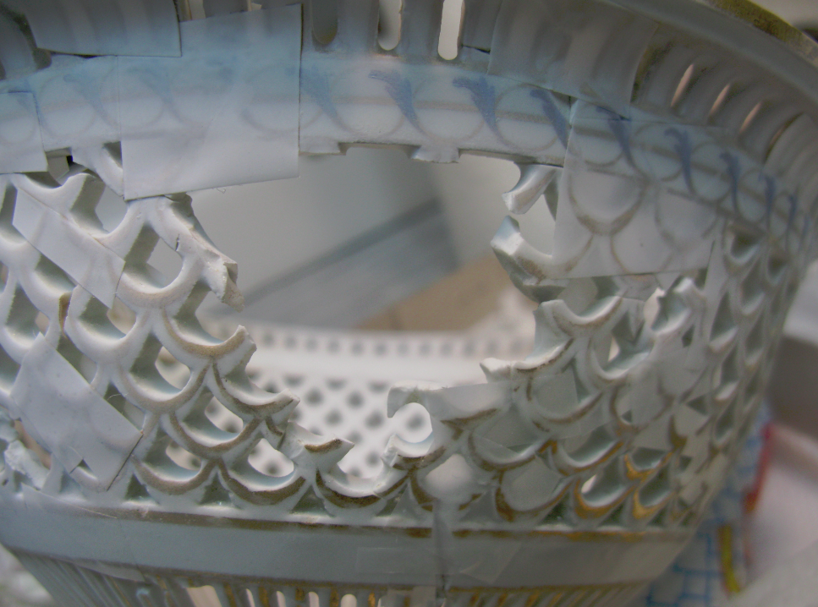
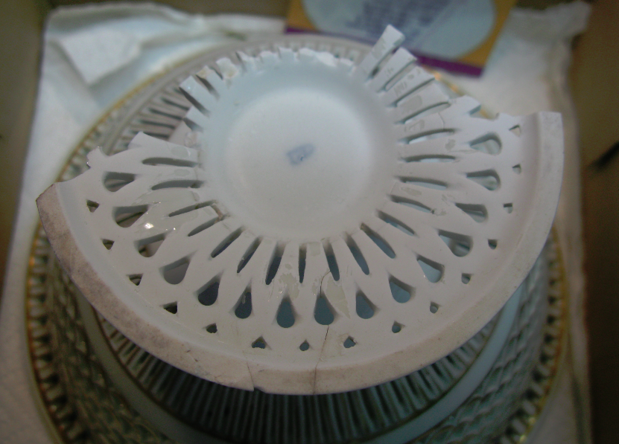
Restoration of a stemmed fruit bowl
The condition of the bowls before restoration
- both fruit bowls had different damages
were masterly restorated in the past
old glue had become brittle during the years and the bowls started to collapse

Slide 19
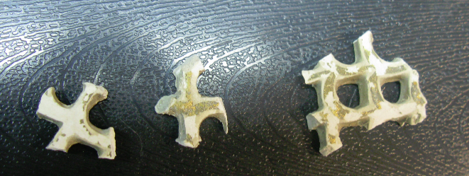
Restoration of a stemmed fruit bowl
Some of the missing areas were replaced with plaster
because of the weak glue, the edges of an added plaster parts were damaged
Plaster
parts
(not porcelain)

Slide 20
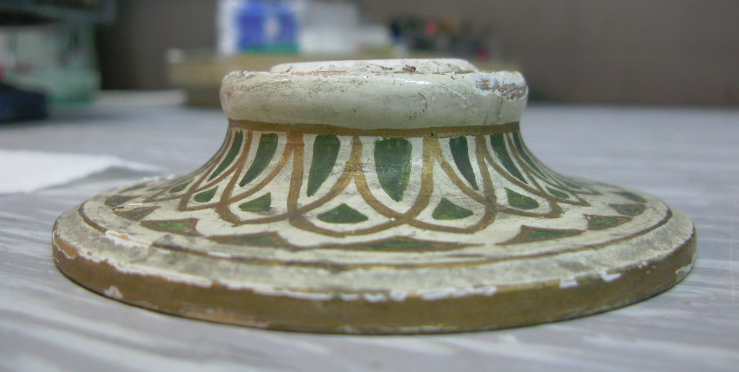
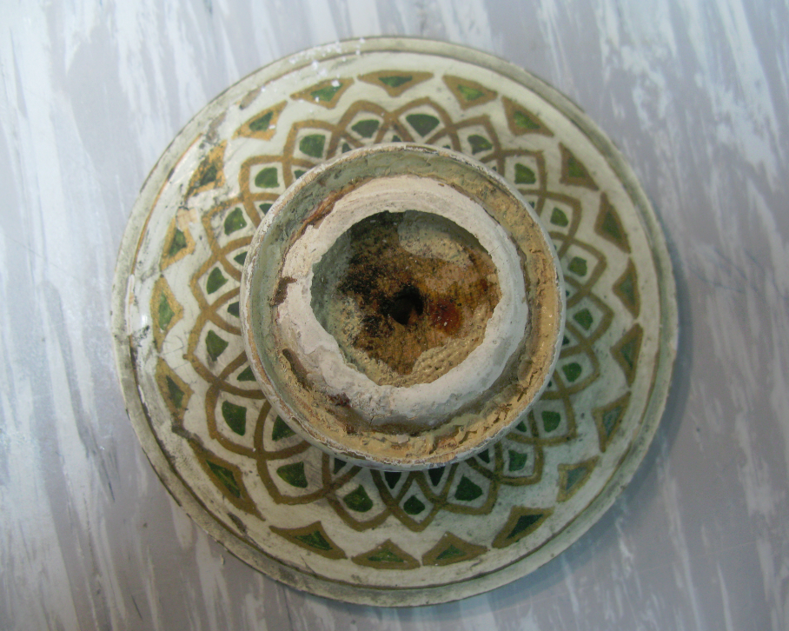
Restoration of a stemmed fruit bowl
The bowl with missing foot
a replica of the foot was made with solid wood and painted to match the object
the foot was little taller than it should have been
We decided not to glue back plaster and wooden parts.

Slide 21
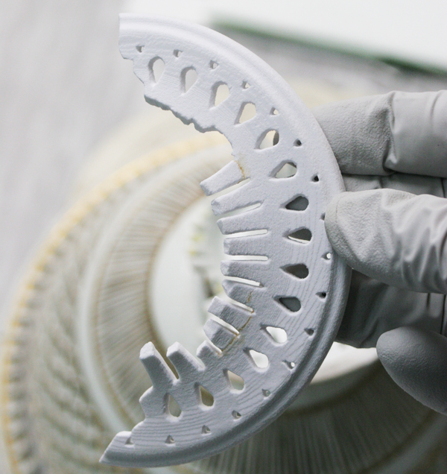
Restoration of a stemmed fruit bowl
The completion of the bowl with the 3D printed fragments
We used 3D printed fragments which were as similar as possible to the shape of missing areas
> they needed very little work to be adapted to the original object.

Slide 22
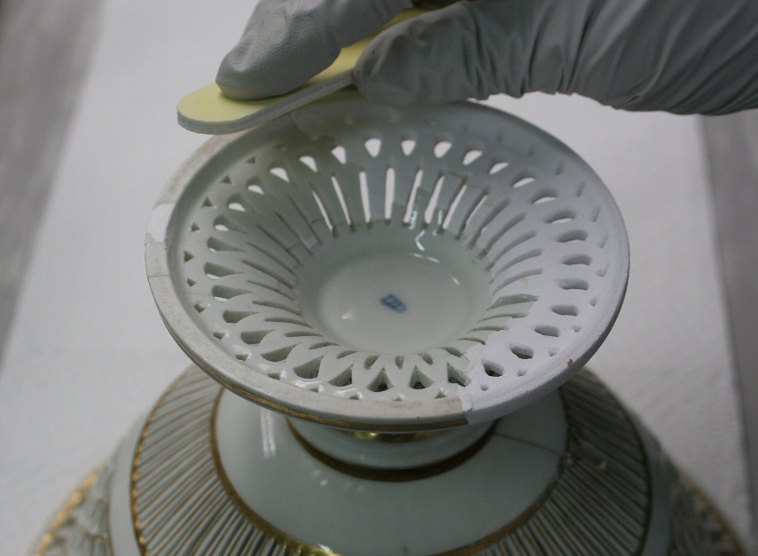
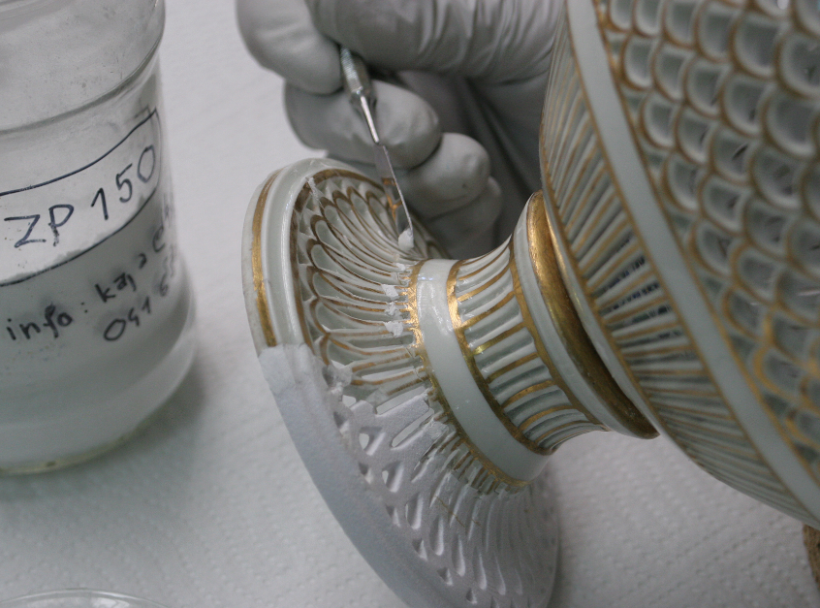
Restoration of a stemmed fruit bowl
Smoothing with emery paper was too rough > coating parts with more layers of epoxy resin to smoothen the surface.
The fragments and the object were glued together with Araldite 2020 (used for restoration of glass and porcelain objects) epoxy resin.
Junctures were finished with a mixture of water and the powder (ZP 150) which was primarily used for 3D printing.

Slide 23
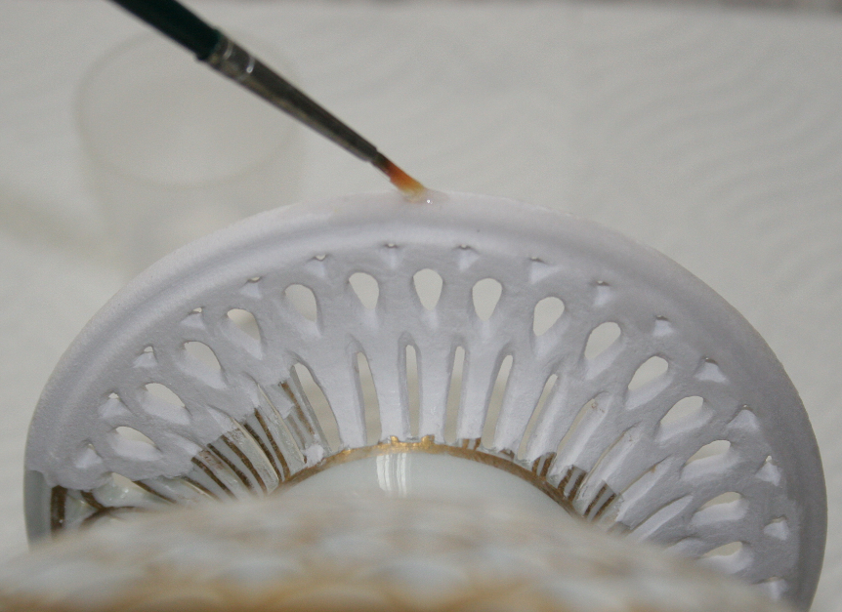
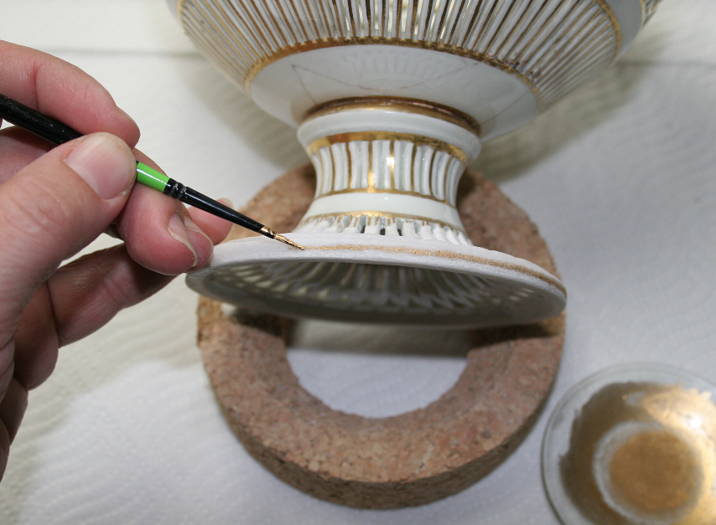
Restoration of a stemmed fruit bowl
Araldite 2020 was also suitable for impregnating 3D printed fragments.
We had to color the used epoxy to match the color of the object.

Slide 24
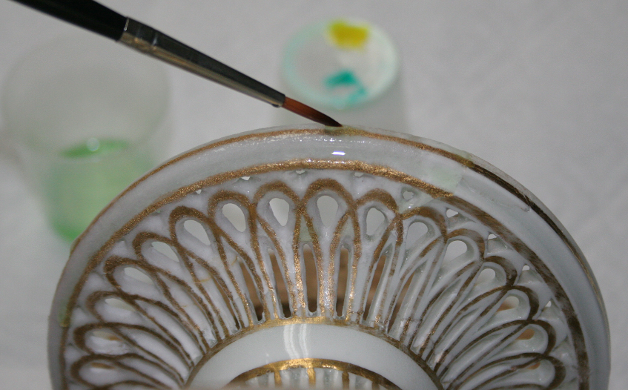
Restoration of a stemmed fruit bowl
When epoxy had hardened, coating with uncoloured epoxy resin whole part was still needed.
That’s how we reached the appearance of a glaze.

Slide 25
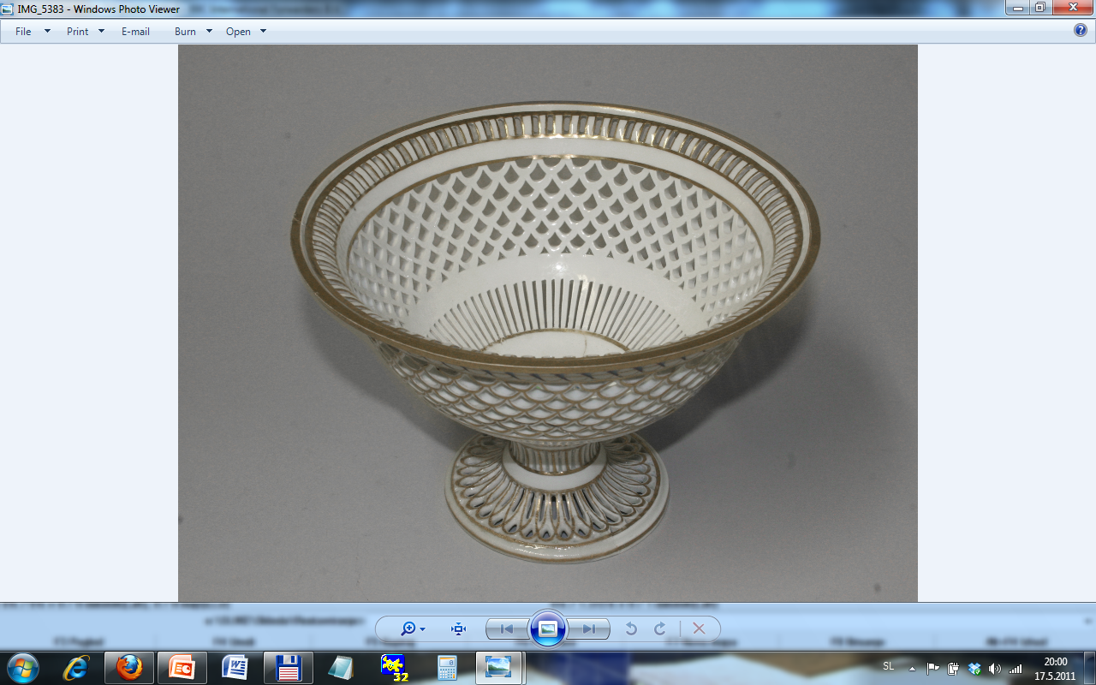
Restoration of a stemmed fruit bowl
Restorated stemmed fruit bowl

Slide 26
Restoration of a stemmed fruit bowl
original object
3D printed
part
Restorated stemmed fruit bowl

Slide 27
Conclusions and further work
Restoration of a stemmed fruit bowl
using 3D technologies
Museum object > 3D digitization > reconstruction > 3D printing > restoration

Slide 28
Conclusions and further work
The presented case shows:
3D technologies are opening new possibilities for making reconstructions and replacing missing areas in objects in several restoration fields
3D technologies simplify restoration work
make it faster, less complicated and more accurate
A collateral product: a 3D digital model, that can be presented virtually
an original object
a reconstructed object

Slide 29
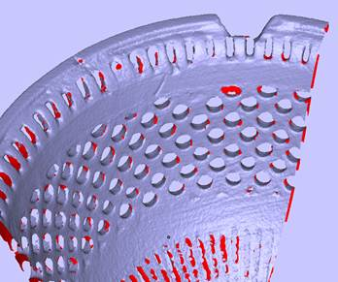
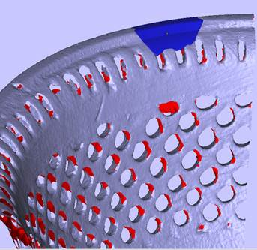
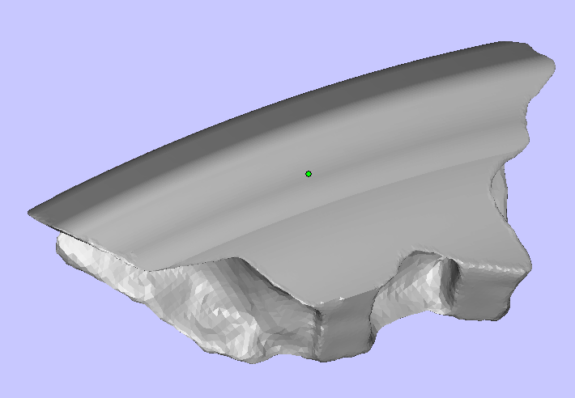
Conclusions and further work
In the first phase of reconstruction we focused only on lager missing parts of the bowls.
The reason was a lack of experiences with including 3D printed parts into porcelain objects.
We are planning to reconstruct and include also smaller parts for both bowls.
… and test other possibilities: transparent material (glass), more coloured objects, more complex objects...

Slide 30
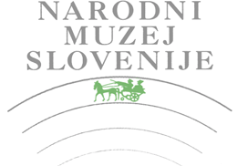


Thank you!
Aknowledgements
This project would not have been possible without an essential support of IB-PROCADD d.o.o. and the National Museum of Slovenia. The project was made under the supervision of doc. dr. Mateja Kos, during Researching program of Young Researcher Kaja Antlej, IB-PROCADD d.o.o. Operation part financed by the European Union, European Social Fund.
Kaja Antlej, Young Researcher, IB-PROCADD d.o.o., kaja@ib-procadd.si

